Slide 1
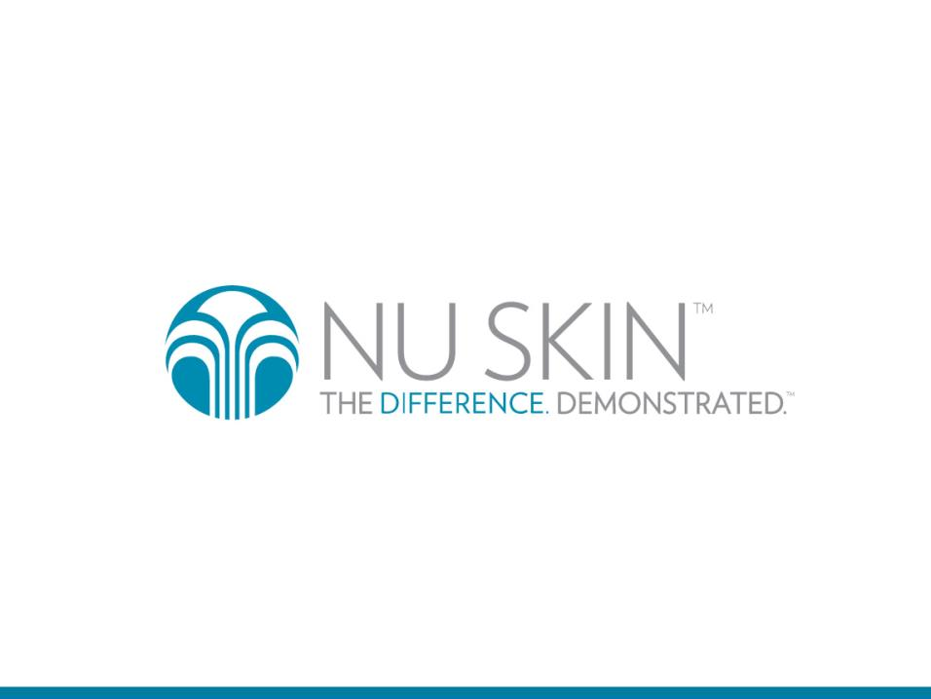

Slide 2
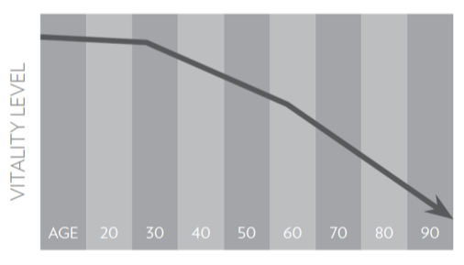


Vitality Declines With Age
As we age, our bodies’ ability to effectively generate and utilize energy declines, which may rob us of youthful vitality.

Slide 3
What would you do with more VITALITY?
Notes:
Read slide

Slide 4

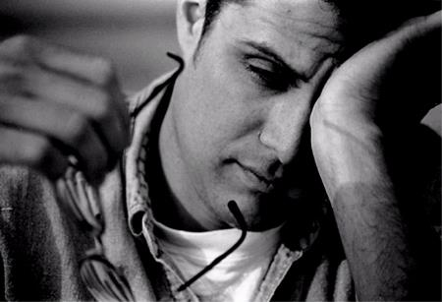
What would you do with more Vitality?

Slide 5

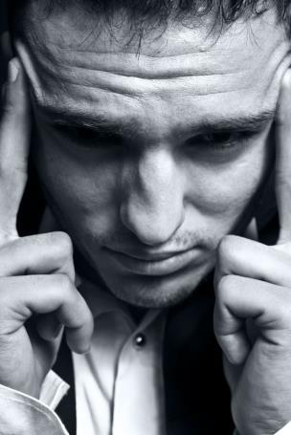
What would you do with more Vitality?

Slide 6
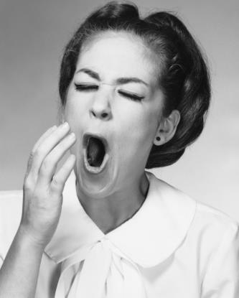

What would you do with more Vitality?

Slide 7

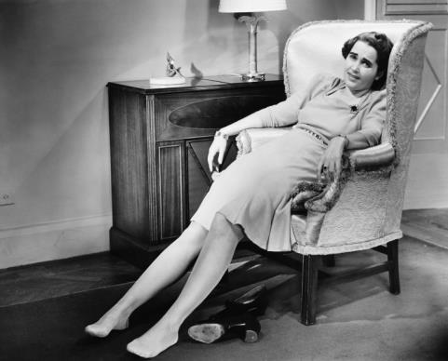
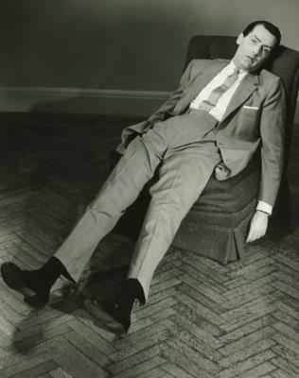
What would you do with more Vitality?

Slide 8

A Global Consumer Need
85% of consumers are concerned about their energy and stamina levels
40% decline in ability to concentrate, from age 30 to 60
As we age, sexual desire declines ~66% in women and ~37% in men
Datamonitor: Global Consumer Fatigue Report. April 2009
Notes:
Loss of vitality is one of the first signs of “feeling older” that people notice.
read stats

Slide 9

Nu Skin is the Premier Anti-Aging Company
Scientific innovation has established Nu Skin as a global leader in the nutritional and personal care industries. Our proprietary processes enable us to set new industry standards in anti-aging, with real solutions that exhibit demonstrable results.
Notes:
Read slide

Slide 10
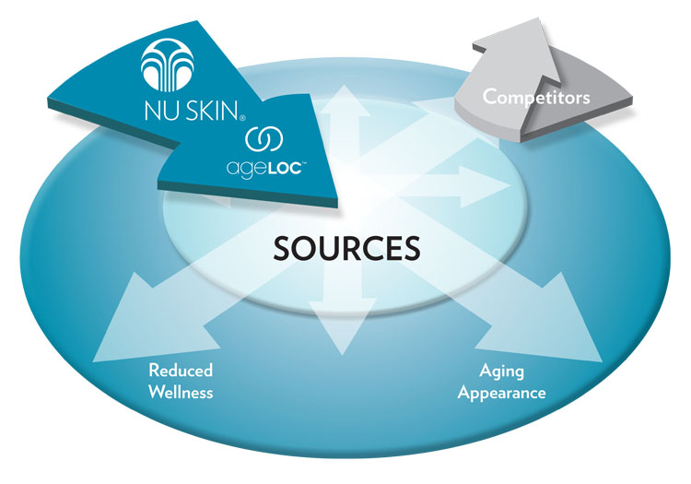
Target the Sources of Aging
Notes:
Competitors in the skin care and nutrition industries merely address the signs and symptoms of aging, such as an aging appearance or reduced wellness. ageLOC Science targets the sources of aging (genes), not just the symptoms.

Slide 11


What If…?
What if we could elevate our youthful vitality by targeting the sources of age-related vitality loss?
What if we could slow this decline, effectively turning back our clock towards a more youthful state?

Slide 12

Age Related Vitality Loss
Three Dimensions:
Physical (endurance, stamina, resistance to fatigue)
Mental (cognition, clarity, focus, memory, alertness)
Sexual (sexual health)
Notes:
Loss of vitality is one of the first signs of ‘feeling old’ that people mention as they age.

Slide 13
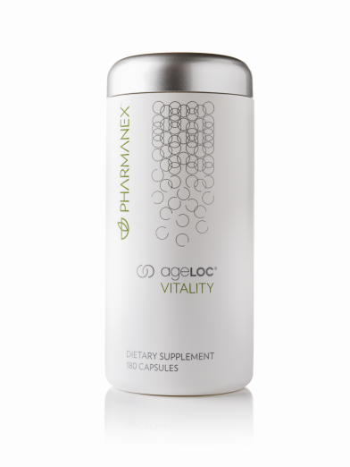
ageLOC Vitality
ageLOC Vitality Improves Three Dimensions of Vitality:*
Physical Vigor
Mental Acuity
Sexual Health
* These statements have not been evaluated by the Food and Drug Administration. This product is not intended to diagnose, treat, cure, or prevent any disease.

Slide 14
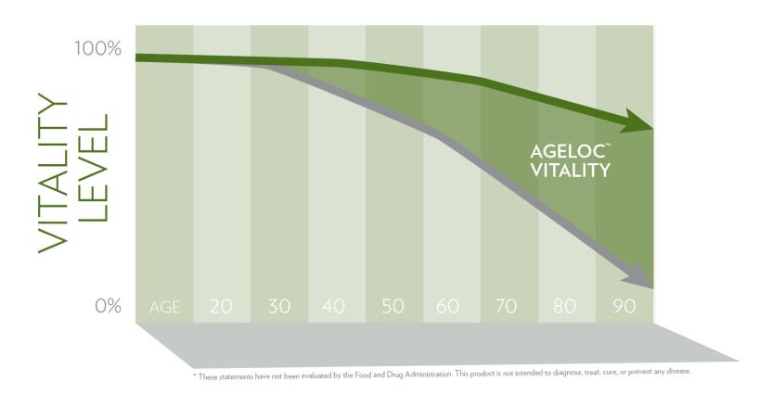
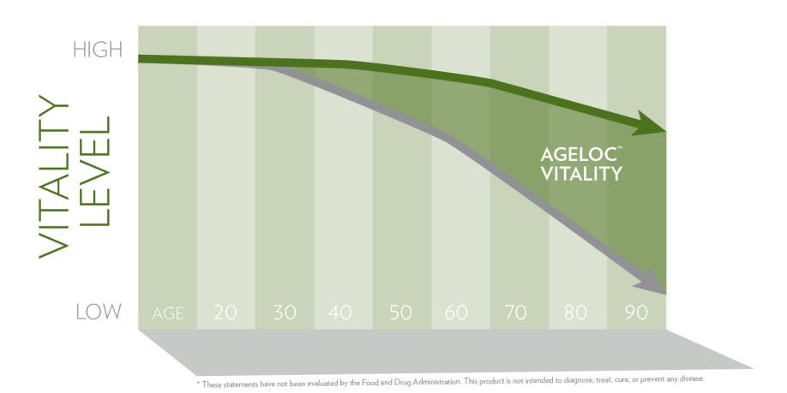
Restore Youthful Vitality
ageLOC Vitality targets the sources of age-related vitality loss by promoting healthy YGC activity.*
This graph is a hypothetical representation of energy decline over time and DOES NOT represent any actual experimental data.

Slide 15

ageLOC Vitality Benefits
Promotes three dimensions of vitality – physical, mental, sexual
Raises and sustains baseline energy levels
“The most significant change for me was the complete mental clarity that I had. There was no mental fog.” Donna E., Nu Skin Distributor – Granite Bay, CA
“After trying ageLOC Vitality I was really clear and very energetic, but not in a way that I was hyperactive.” Leslie G., Nu Skin Distributor – Malibu, CA
* These statements have not been evaluated by the Food and Drug Administration. This product is not intended to diagnose, treat, cure, or prevent any disease.

Slide 16
Testimonial
“ageLOC Vitality is amazing! After a day or so I noticed my energy level was so high I wanted to work out. I am sleeping better and can’t wait to get up. After two weeks, I feel like I did 15 years ago. Mentally I can now focus and be at high intensity during appointments all day without being exhausted. I love ageLOC Vitality!” Ann H., Nu Skin Distributor – Dallas,TX
“The second week taking ageLOC Vitality I really saw improvement in my overall energy, and I saw significant improvement in my workouts. I like to be active and play sports. I soon noticed a dramatic difference in the amount of weight I could lift and how far I could run. I’ve never taken another product that provides this type of sustained, healthy lift for me.” Scott B., Nu Skin Distributor – Highland, UT
I am feeling incredible on our new Vitality product! For me it is a great alternative to coffee, soda and energy drinks which would give me "jittery" energy that I would crash from later in the day. They also tend to be very acidic and hurt my stomach. After taking this product I'm down from 3 cups of coffee per day, to just 1/2 cup in the morning. And that's just habit- I don't even need it! The best part is, I no longer get that "2:30 feeling" later. Eric K., Nu Skin Distributor – Las Vegas, NV
* These statements have not been evaluated by the Food and Drug Administration. This product is not intended to diagnose, treat, cure, or prevent any disease.
Notes:
Read slide

Slide 17
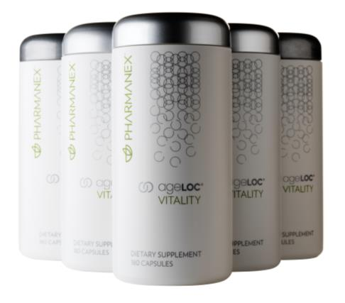
Stop wondering what you would do with more vitality.
Order yours today!

Slide 18
Claims Reminder for Distributors
CAN SAY:
Can make approved structure/function claims from corporate marketing materials. These include:
Achieve greater physical vigor, mental acuity, and sexual health – by targeting the sources of age-related vitality loss. Reset, revive, and renew with ageLOC Vitality.
Can suggest customers talk to their healthcare provider for diagnosis or treatment options for ANY healthcare concerns.
Can share positive personal testimonials that are consistent with approved claims
“I feel more energetic”
“I feel that I have greater mental clarity, sharper focus”
CAN’T SAY:
Cannot claim to treat, cure or prevent any disease (or that the product cured your own ailment)
Cannot instruct customers to stop taking an Rx drug without talking to their health care provider
Cannot offer advice about drug-supplement interactions
Do not practice medicine, nursing or dietetics without a license – Don’t diagnose
Do not use testimonials unless they are typical of what every consumer can expect

