Slide 1

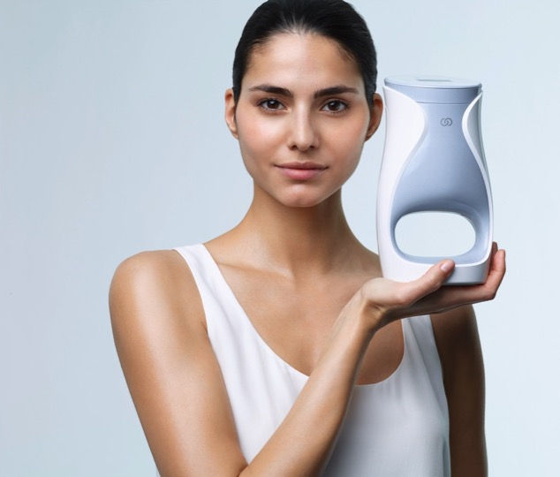
LET’S TALK ABOUT
Notes:
Let’s talk about me. Not ME, but ageLOC Me. Because it’s so personal and individual that it’s really about you, and me, and all of us.

Slide 2

The anti-aging industry is growing.
The aging population is increasing and younger people want to avoid early signs of aging.
REVIEW: TRENDS
THE GLOBAL MARKET
FOR ANTI-AGING PRODUCTS
IS SET TO REACH $346 BILLION BY 2018.
“ANTI-AGING PRODUCT AND SERVICES: THE GLOBAL MARKET,” BCC RESEARCH, AUGUST 2013

Slide 3

Skin care is a rapidly growing category.
REVIEW: TRENDS
Skin care is set to reach $405 billion by 2017, growing by more than $55 billion in 5 years.
EUROMONITOR INTERNATIONAL, JULY 2014

Slide 4
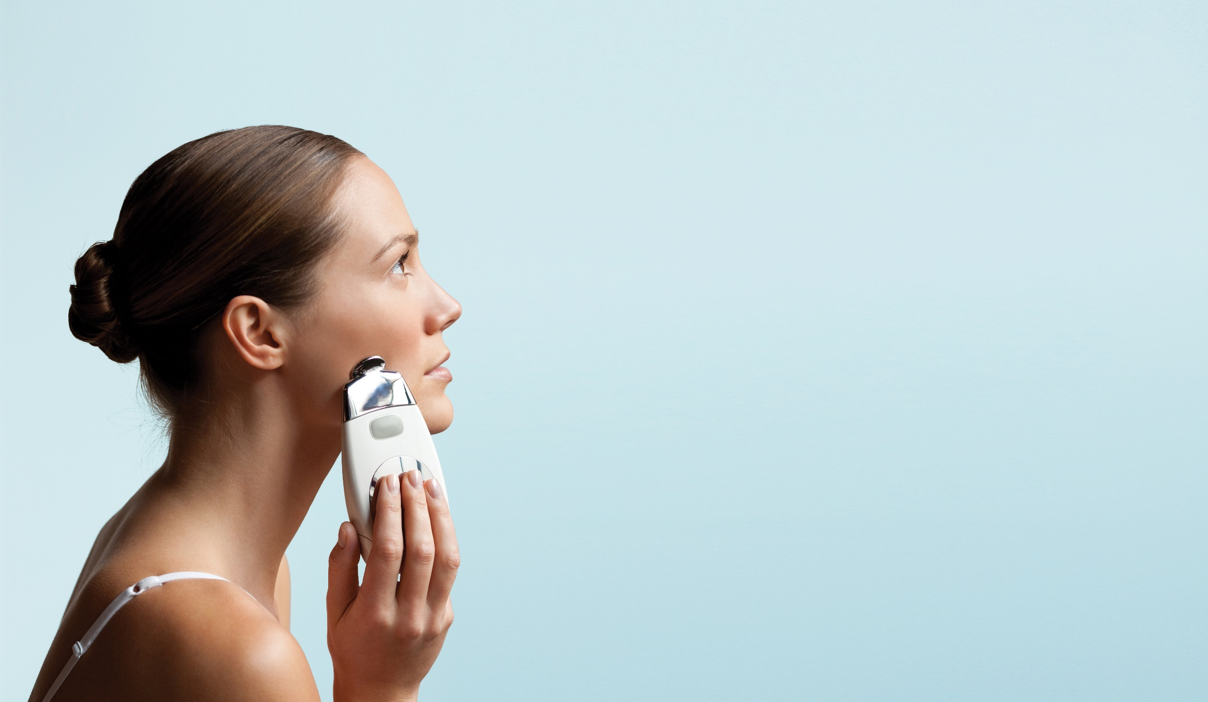
High-tech beauty gadgets are in high demand.
REVIEW: TRENDS
70%
OF WOMEN WOULD LIKE TO OWN A NEW BEAUTY DEVICE.
“BEAUTY DEVICES ARE ‘CREATING A NEW BENCHMARK IN FACIAL SKINCARE,’” COSMETICS DESIGN, 2013

Slide 5
Product customization is becoming increasingly popular.
REVIEW: TRENDS
Consumers are moving away from traditional, mass-produced products. They are increasingly looking for solutions that fit their specific needs and engaging in product creation.
“FIVE GAME-CHANGING CONSUMER TRENDS,” BUSINESS DEVELOPMENT BANK OF CANADA, 2013
Notes:
Consumer customization is happening with shoes, cars and even makeup now!

Slide 6
Consumers seek expertise, simplicity & convenience.
REVIEW: TRENDS
Consumers often seek guidance from experts on which beauty items to buy.
But once they know their regimen, they look for ways to simplify the buying process.
“SHOPPING FOR BEAUTY PRODUCTS,” MINTEL, US, DECEMBER 2013

Slide 7
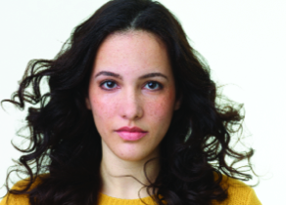




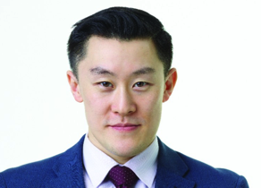


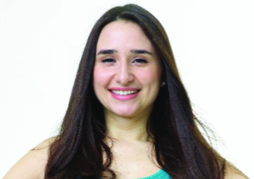
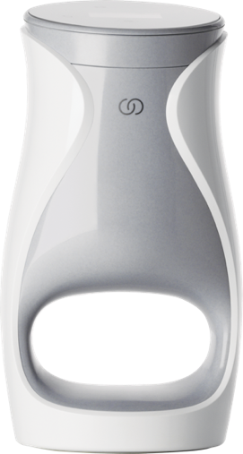
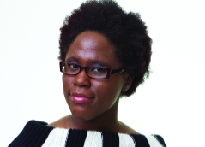

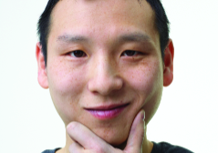

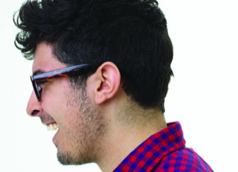

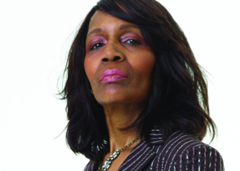
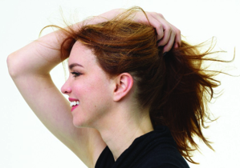

let’s talk about me
Notes:
Each of us is unique. We have our own individual tastes, preferences, likes, and dislikes. There are so many things we customize every day—things we custom fit and tailor to our world.
But skin care has been pretty straightforward and more one-size-fits-all for a really long time. At Nu Skin, we understand that something as personal and individual as skin care needs to be more personalized and more customizable to deliver the best benefits and results.

Slide 8
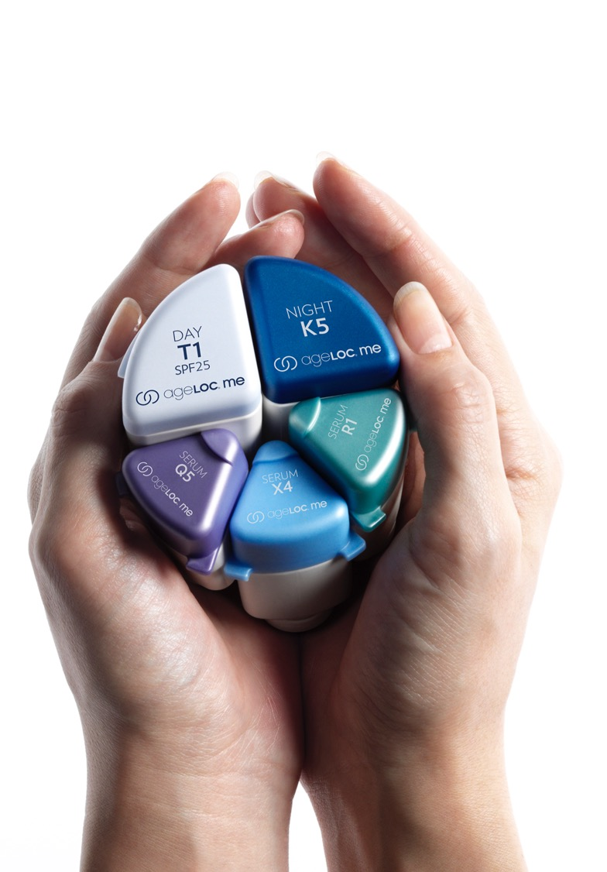
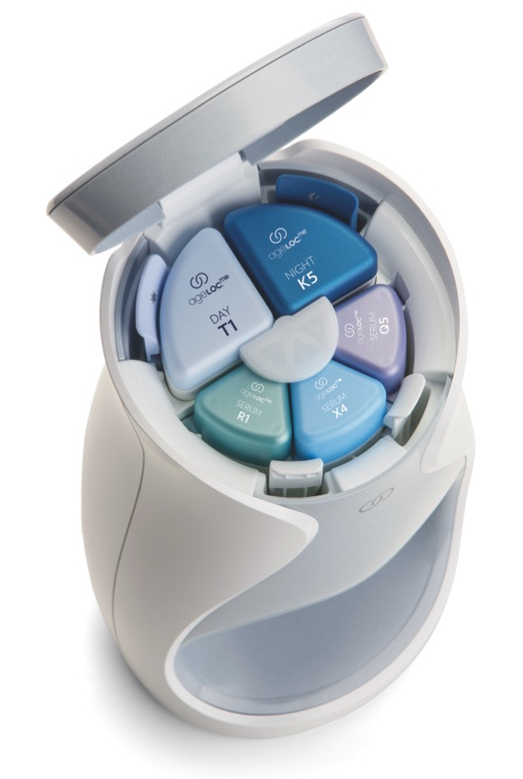
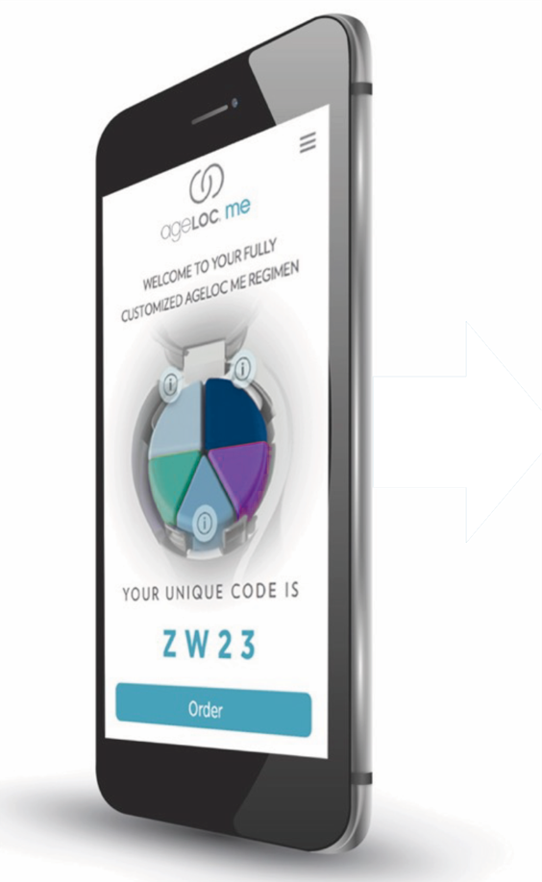
let’s talk about me
s
Notes:
ageLOC Me is revolutionary and truly is the future of skin care because it’s customized TO YOU.
One key element of the system is the app, where you tell us about you. The app will ask you things like your gender, where you’re from (because climate matters), your background, what your aging concerns are, and what your hopes are in terms of skin care and what you’re trying to achieve. The app then puts your responses into a sophisticated algorithm that takes all the magic of our R&D, our more than 30 years of genetic science, and our expertise in skin care, to create a custom regimen for you.

Slide 9
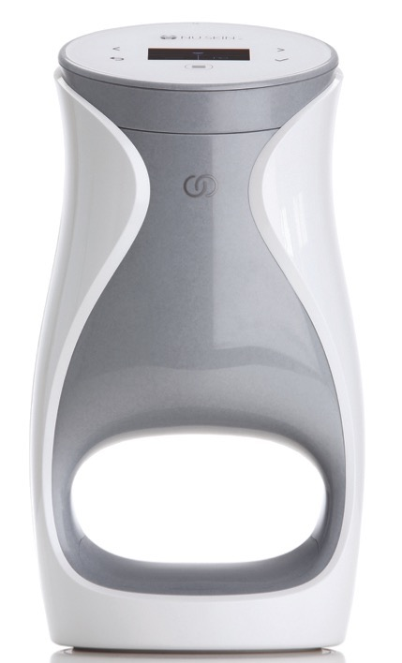
let’s talk about me
let’s talk about m
NEXT GENERATION SKIN CARE
ageLOC Me™ provides skin care that cannot be put in a jar.
Higher level of serum active ingredients when mixed at the moment of use.
Notes:
Nothing like this has ever been done before and it is truly a remarkable accomplishment—to take a category that has been the same for many, many years and serve it up in a completely new way. Providing products that are customized to you, making ageLOC Me the next generation in skin care.

Slide 10
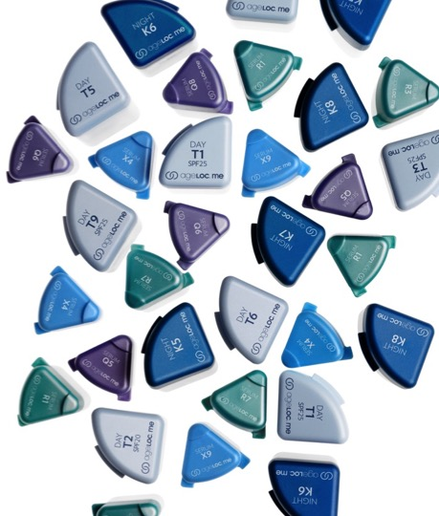
let’s talk about me
let’s talk about me
ALMOST 2,000 POSSIBLE REGIMEN COMBINATIONS
Notes:
With personalized regimens that are custom selected for you from more than 2,000 possible regimen combinations.

Slide 11
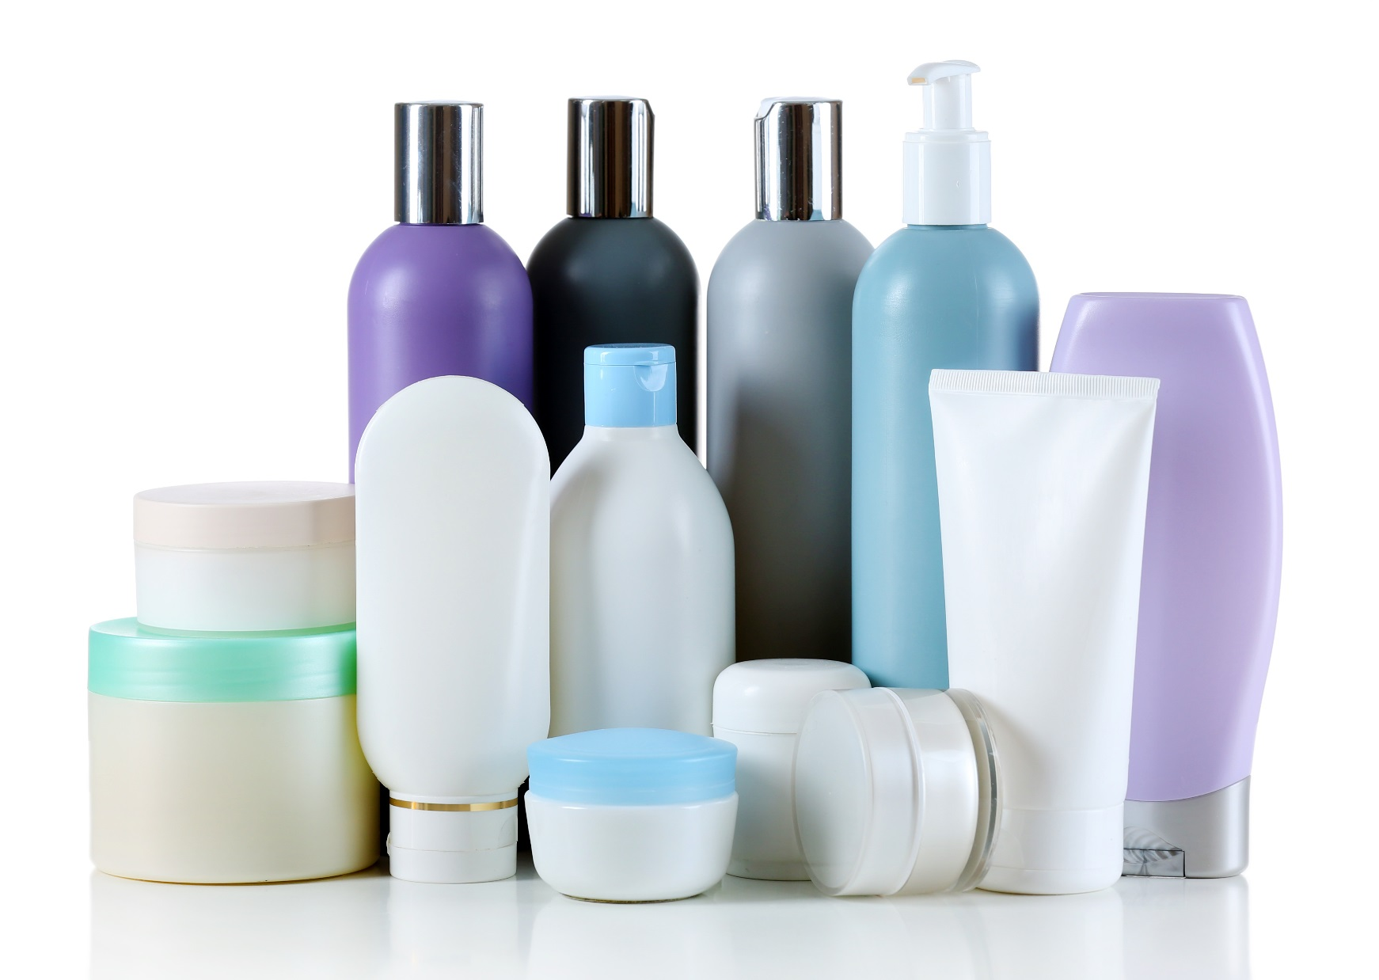
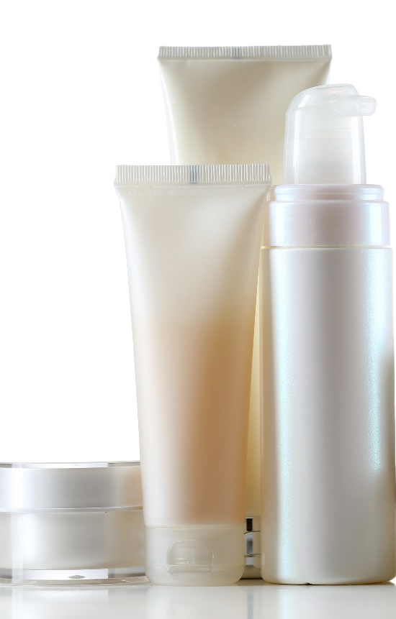
let’s talk about me
CONVENIENT AND EASY TO USE
Notes:
There are millions of products in the global beauty industry. Some people are really good at curating their own regimens and know what they want. Others, however, are intimidated by skin care and may be confused by all the options that are available. They may not know what’s right for them. That’s what is so great about ageLOC Me. Even if you’re a skin care novice, you can easily find a regimen that will deliver the best results for your skin.
With ageLOC Me, you don’t need to crowd your vanity or bathroom cabinet with dozens of bottles, tubes, and jars. ageLOC Me is simple, convenient, and easy to use.

Slide 12
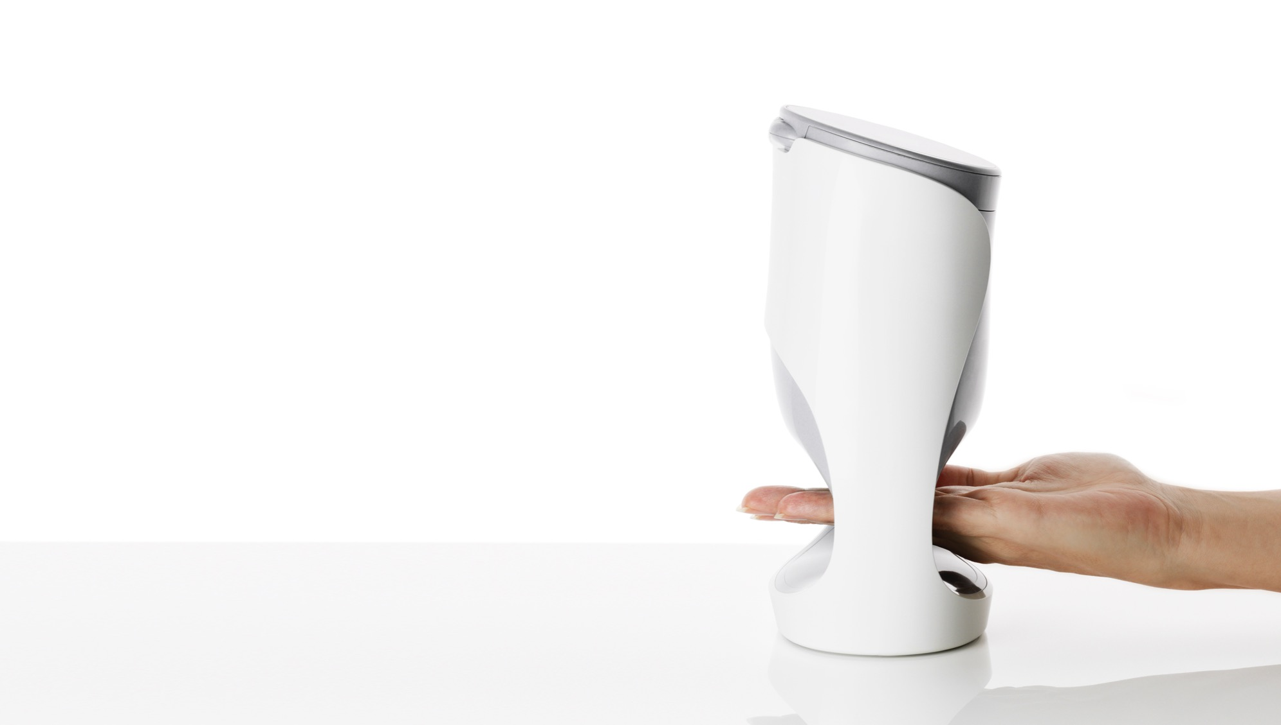
YOUR PERSONAL SKIN CARE LAB
Notes:
We like to refer to it as your personal skin care lab. There’s a magic that happens when the device delivers your personal, customized products every morning and every night.

Slide 13
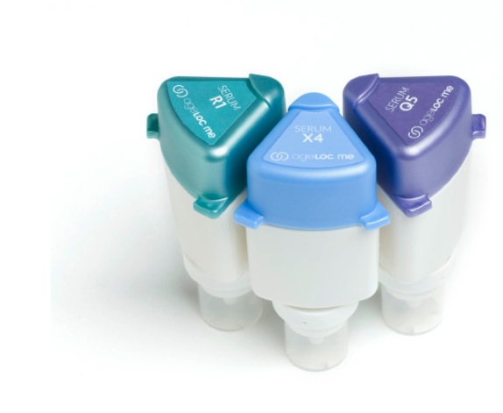
AGELOC ME™ SERUMS
Helps with Cellular Turnover
Diminishes Pigmentation
Helps Target Lines/Wrinkles, Firmness
Notes:
Cellular Turnover
Specialized ageLOC Me Serum helps improve cellular turnover to refine texture, reduce the appearance of pores, and reveal smoother, softer skin—for a noticeably younger looking you.
Pigmentation
Specialized ageLOC Me Serum helps prevent the visible signs of hyperpigmentation and age spots to reveal more even, radiant skin—for a noticeably younger looking you.
Lines/Wrinkles, Firmness
Specialized ageLOC Me Serum helps improve the visible signs of lines, wrinkles, and sagging—for a noticeably younger looking you.

Slide 14
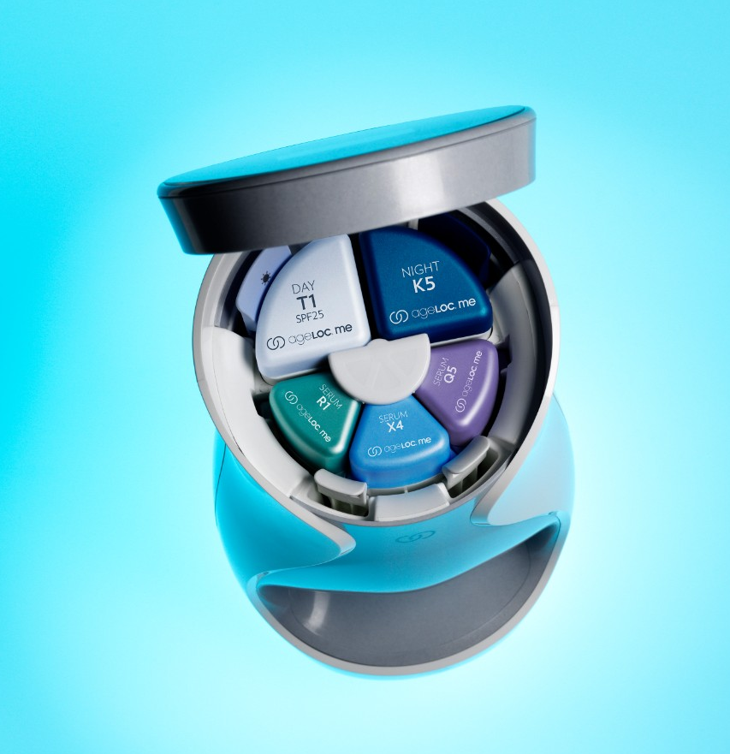
SUPER SERUMS
Higher concentration of active ingredients
Combine to provide a higher amount and potency of key ingredients that could not be formulated into a single product
Notes:
Designed with customization in mind, we have separated the “treatment” products into three separate serums. This novel approach allows for three targeted serums with ingredients focused on particular skin concerns that combine prior to use. So not only does it allow for customization, but it enables a larger array of key ingredients at potentially higher concentrations than what we could easily formulate into a single product. This results in a better product for you.

Slide 15
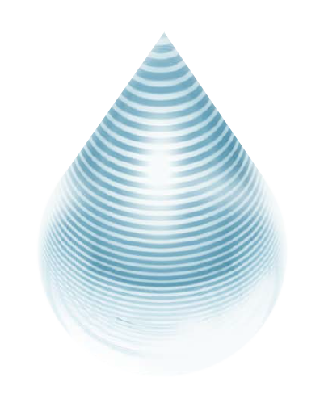
REVOLUTIONARY MICROLAYERING TECHNOLOGY
The ageLOC Me™ device weaves the customized serums together into 40 layers to evenly distribute key ingredients, optimizing the serum combination and resulting in increased absorption of formulations into the skin.
Notes:
Some people say it looks great, and it sounds great, but what’s really happening inside the device? How can you deliver better ingredients in a more efficacious way than we historically have? The answer is our proprietary microlayering technology. The ageLOC Me device weaves the customized serums together into 40 layers and delivers them at the moment of use, evenly distributing the key ingredients, optimizing the serum combination, and resulting in increased absorption of anti-aging formulations into the skin.

Slide 16
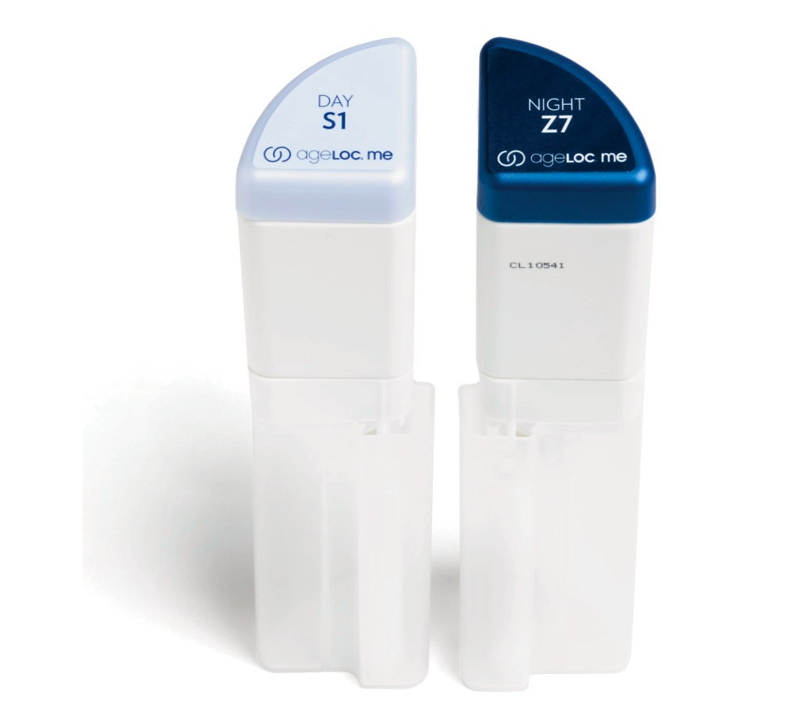
AGELOC ME™ MOISTURIZER BENEFITS
Moisture Barrier
Calms, soothes, and rejuvenates
Customize for Skin Type
Customize for Texture
Customize for Fragrance
Customize for SPF
Notes:
Provide hydration to strengthen and maintain the skin’s natural moisture barrier
Day Moisturizer provides optional broad spectrum protection from UVA and UVB radiation with SPF 20/25
Night Moisturizer calms, soothes, and rejuvenates skin during its natural nighttime recovery process
Formula combinations are suitable for different skin types, including dry, normal, combination, and oily skin.
Offer different options for texture and overall feel based on climate, skin type, and personal preference
Customizable elements include fragrance/non-fragrance and SPF/non-SPF

Slide 17
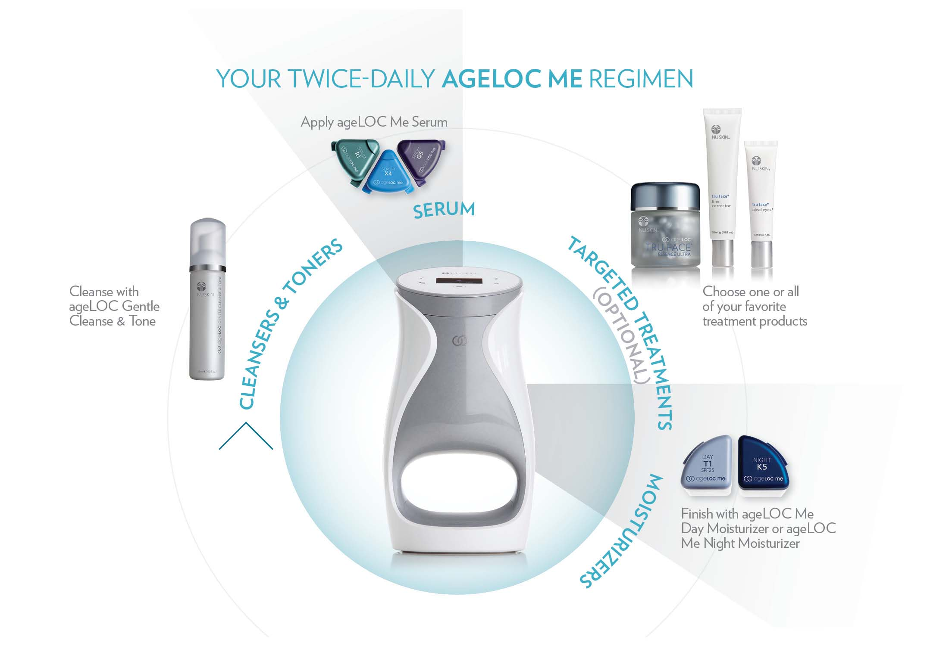
Notes:
And of course all the other Nu Skin products you know and love can fit easily into your ageLOC Me regimen.

Slide 18
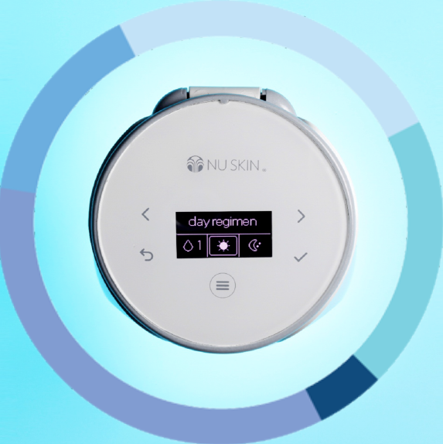
your personal skin care lab
SMART DELIVERY DEVICE
FORMULATED AT MOMENT OF USE
Delivers the best, most effective product just for you at the moment of use.
Your customized formula— morning and night
Simplicity increases compliance
Notes:
One of the main problems we find in skin care is that people aren’t always compliant. People have a hard time remembering to use their products the right way in order to get maximum benefits. But ageLOC Me reminds you to use your products daily and delivers them in a precise dose so you get the best results—the results you need and desire, every day.

Slide 19
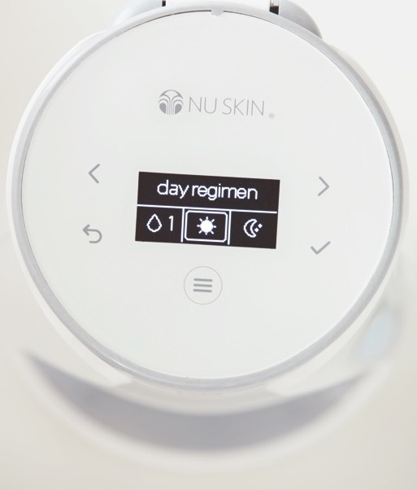
KEY FEATURES
Automatic dispense
Hygienic, hands-free delivery
Learns habits, provides reminders
Tracks usage, & reorder reminders
Travel mode and containers
“Lock” mode for transporting
Notes:
Not even Apple has figured out how to get their iphone to automatically do what you want without touching it. But with ageLOC Me you simply walk up to the device without touching a single button and you can receive your day regimen or night regimen automatically. I think by now you realize that it is hands-free, in fact with these new airless, custom-valved packages, the formulations never touch anything but your skin and the device never needs cleaning, the most hygeniec skin care experience possible. It’s also a learning device – it knows your habits and provides a gentle reminder if you forget your regimen. Of course the device tracks the amount of product remaining in each package and prompts you to reorder so you are never without your ageLOC products. It also features a built-in travel mode: simply tell ageLOC Me how many days and nights you will be travelling and it will dispense the exact doses of serum and moisturizers into compact travel containers included in your starter kit. Also a lock mode for transporting the device or to put it to battery conserving sleep if it is unused for 48 hours.

Slide 20
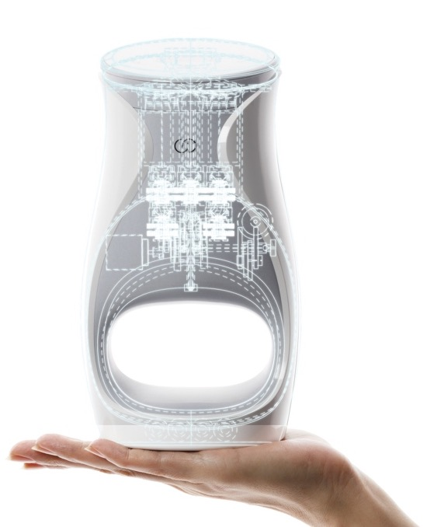
your personal skin care lab
let’s talk about me
WORLD-CLASS ENGINEERING
27 ageLOC® patents or patents pending
5 of which are for ageLOC Me
Notes:
We protect our intellectual property. ageLOC Me employs world-class engineering and is exclusive to Nu Skin—and only YOU have the ability to share it with the world. Our proprietary ageLOC science boasts 27 patents or patents pending. This means no other company on the planet can offer this level of innovation.
And in case you’re wondering, 5 of the 27 patents cover ageLOC Me’s mechanisms for delivering customized skin care to you.

Slide 21
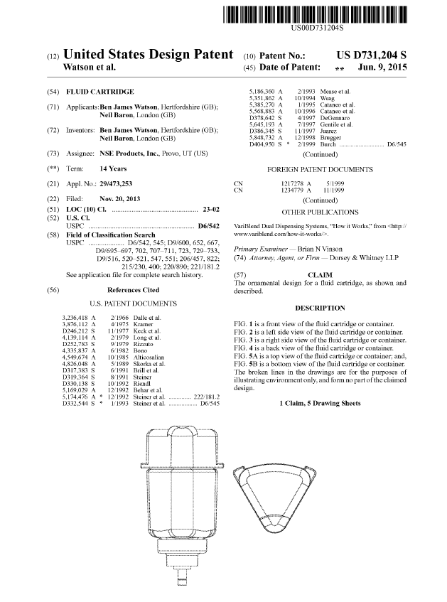
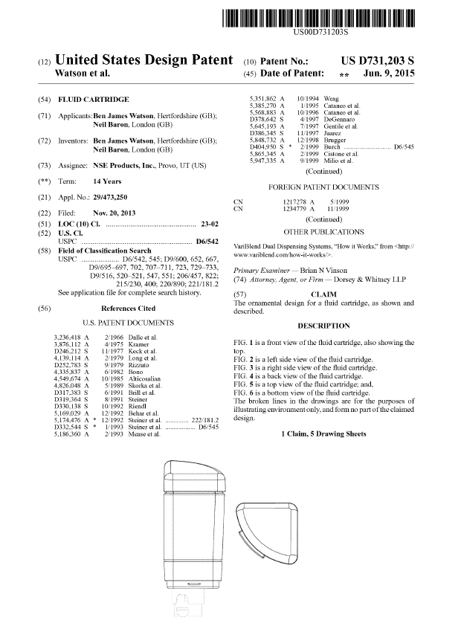
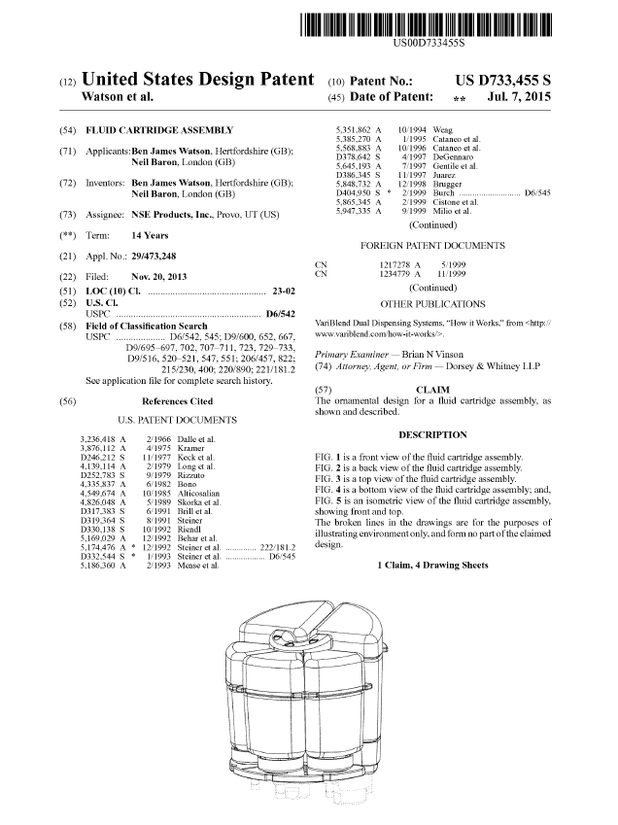
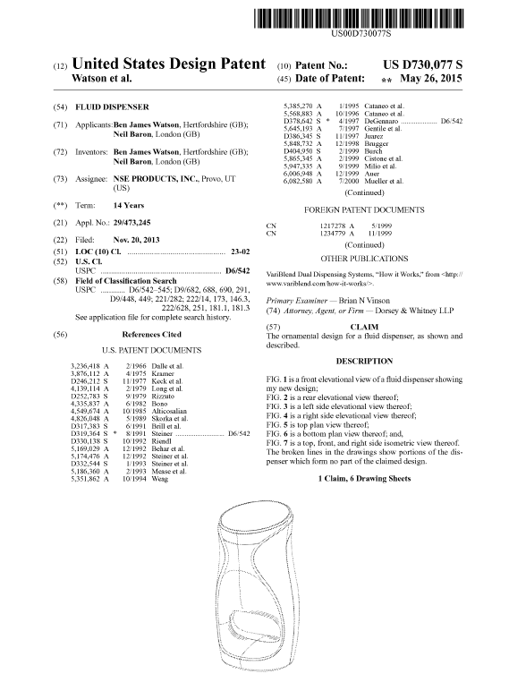
FIVE NEW PATENTS RELATED TO MECHANISMS FOR DELIVERING CUSTOMIZED SKIN CARE
Notes:
Our ageLOC Me patents cover mechanisms for delivering customizable skin care (fluid cartridge, device, and assembly). We have protected our intellectual property to ensure that no one else can sell what you (the distributor) are selling. Our patents help ensure there is no concern of others copying our intellectual property and making the same claims.

Slide 22
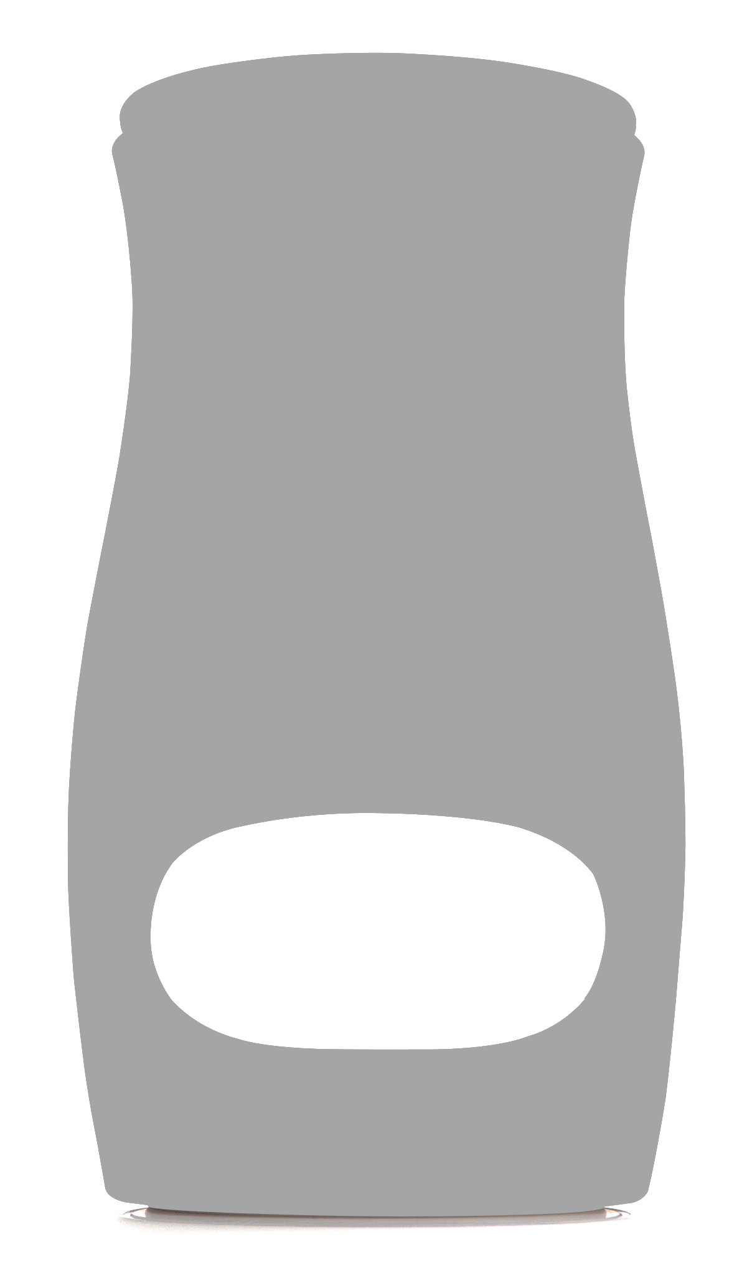
your personal skin care lab
$35
million
invested
Notes:
We decided to change the landscape of the skin care industry and we invested our time, passion, and financial resources to bring ageLOC Me to you and your customers. ageLOC Me represents the most ambitious product development endeavor in Nu Skin’s history.
After several years of intensive research and development and a more than $35-million investment, we have invented a skin care system with product formulations customized to you.

Slide 23
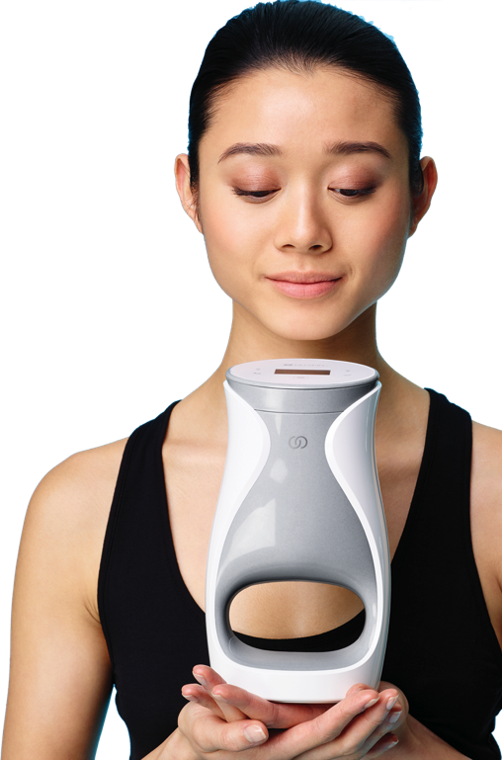




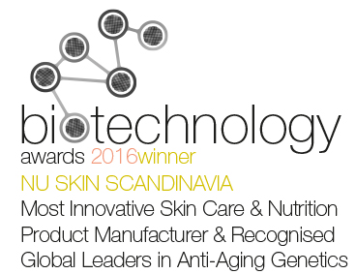
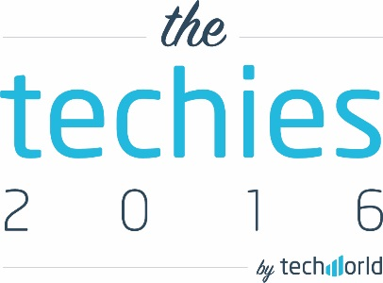

your personal skin care lab
WORLD-CLASS DESIGN
Notes:
Nothing like ageLOC Me has ever been done before and it is truly a breakthrough in the beauty industry. So far, we’ve received these awards for our design and innovation.

Slide 24
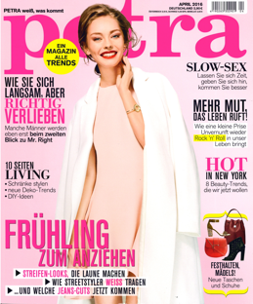

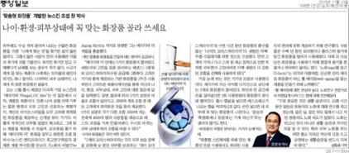


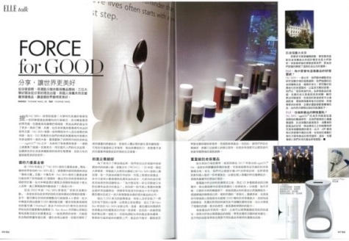
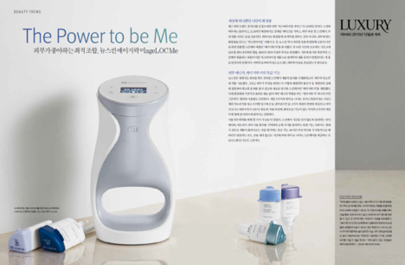
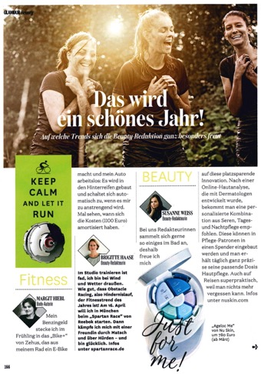
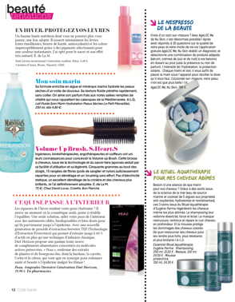
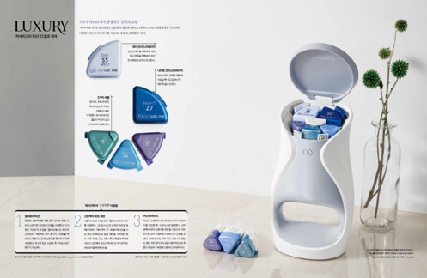
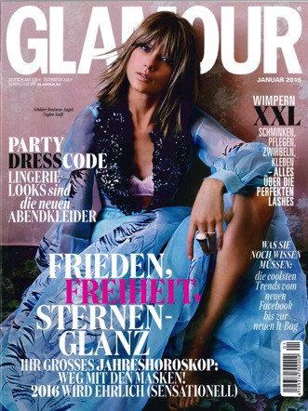
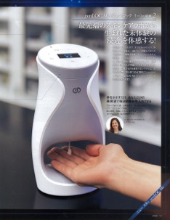
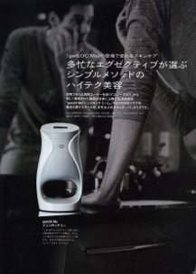
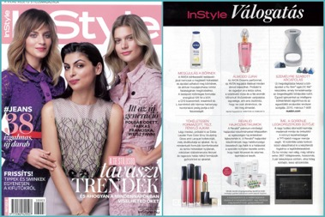


Slide 25

RESEARCH & CLINICAL RESULTS

Slide 26

AGELOC ME™ CLINICAL TESTING
Safety is key. Our Clinical Lab performed more than 200 sting and irritation safety tests in 2014.
Efficacy is proven. We conducted 50+ in-house exploratory or confirmatory in-house clinical studies in 2014, lasting from one day to 16 weeks in duration.
Results are validated. In 2014, we conducted more than 200 studies or tests at third-party research facilities.
Notes:
Our Clinical Lab conducts preliminary safety, efficacy, and consumer-use studies that provide valuable insight during development and evaluation of our products. Safety is key. In 2014 alone, our Clinical Lab scientists performed more than 200 sting and irritation safety tests. They also conducted more than 50 in-house exploratory or confirmatory in-house clinical studies, which lasted anywhere from one day to 12 weeks in duration to ensure product efficacy. Finally, third-party substantiation is critical. Our scientists conducted more than 200 studies or tests at third-party research facilities in 2014.

Slide 27
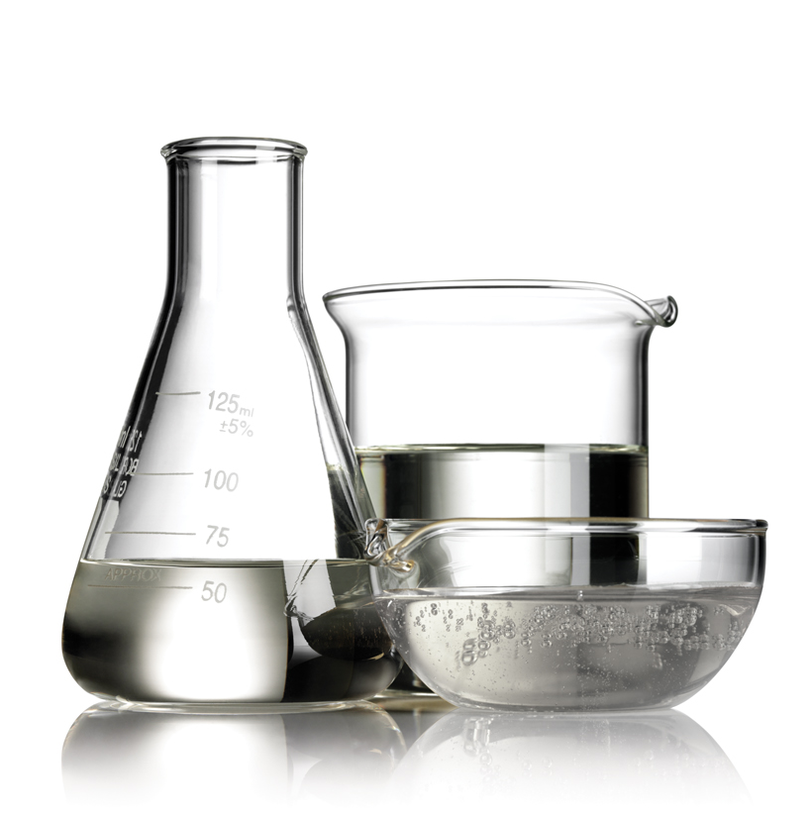
Ageloc me™ formulations
In 2014, we:
made over 700 laboratory batches
worked on 170 different formulas
created up to 50 different iterations per formula
sent 279 batches/formulas through Microbiological Challenge Test Protocol
tested over 11,000 micro plates
tested over 370 batches for stability
Notes:
We recently completed the most ambitious product development project in Nu Skin history.
In our 2014 development of ageLOC Me, we
made over 700 laboratory batches
worked on 170 different formulas
created up to 50 different iterations per formula
sent 279 batches/formulas through Microbiological Challenge Test Protocol
tested over 11,000 micro plates
tested over 370 batches for stability

Slide 28
THE RESULT: 3x MORE PENETRATION/ABSORPTION INTO SKIN* AND MORE ACTIVES DISTRIBUTED EVENLY INTO THE SKIN—BETTER RESULTS
AGELOC ME MICROLAYERING TECHNOLOGY™ WITH AGELOC ME DEVICE
Serums
R
X
This image is of a cross-section drawing of skin (stratum corneum)
3x
Q
* Combining the three serums using the ageLOC Me device (ageLOC Me microlayering technology) results in improved absorption into the skin as compared to hand mixing.
* “Absorption into the skin” refers to the stratum corneum.
* 3x was calculated by dividing the average data points of combining through device (microlayering technology) vs. hand mixing
Stratum Corneum
This chart shows each serum is evenly distributed using microlayering technology; thus all three serums maintain their active power.
MIXED BY HAND WITHOUT AGELOC ME DEVICE
R
Serums
X
This image is of a cross-section drawing of skin (stratum corneum)
Q
Stratum Corneum
This chart shows serums not evenly distributed because they were mixed by hand.
Notes:
Nu Skin (2015). [In-Vitro Data Illustrating the Differences in Skin Absorption Based on Combination Methods of ageLOC Me Serums]. Unpublished raw data.
During our development we were concerned that combining the three serums inadequately would allow for hot spots or missed areas on the skin. We have identified that through the ageLOC Me device the serums are evenly dispersed. This ensures that all three serums are adequately spread throughout the combination prior to application on the skin, therefore when applied each serum will reach and is equally represented in all areas of the application site—your face.
Additionally, we commissioned a third party testing house to measure the differences in absorption of a key ingredient when the serums are combined via the ageLOC Me device versus when the device was not used. Amazingly, the ageLOC Me Device combination resulted in three times better absorption into the stratum corneum than the non-ageLOC Me serum combination. This shows another benefit of the ageLOC Me Device; it is undoubtedly a key part of the ageLOC Me System.

Slide 29

THE FOLLOWING RESULTS COME FROM HOME USE TESTS:
92%
BETTER WAY TO DELIVER SKIN CARE
95%
REPLACE CURRENT
PRODUCTS
96%
MAKE SKIN CARE
EASIER
99%
DEVICE IS EASY TO USE
Nu Skin (2015). [Combined US Home Use Tests]. Unpublished raw data.

Slide 30
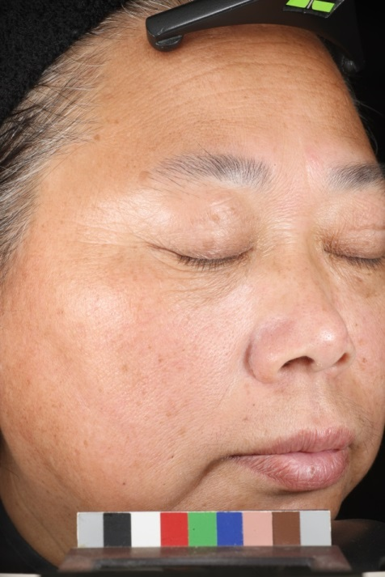
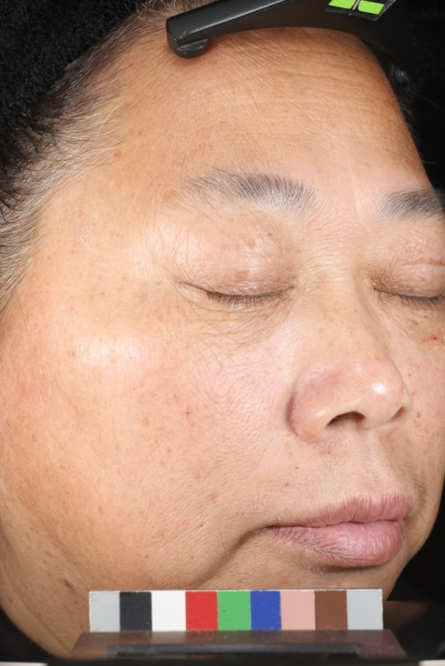
Clinical Results: Subject 1 after 12 weeks
Before
After
Visible improvements in crow’s feet
Prepared for Nu Skin (2015). [12-Week Clinical Study to Evaluate Anti-aging Efficacy of ageLOC Me™ Serums]. Unpublished raw data.
The pictures shown were taken at baseline and at the conclusion of a 12 Week clinical study Nu Skin contracted out to a 3rd party research organization in China. 60 participants were recruited and were split into two groups. Each participant was randomly assigned to one of two predominant ageLOC Me serum combination. Clinical grading, self-assessment, instrumentation and photos were completed at Baseline, Weeks 1, 2, 4, 8 and 12. October 2015.
Notes:
Prepared for Nu Skin (2015). [12-Week Clinical Study to Evaluate Anti-aging Efficacy of ageLOC Me Serums]. Unpublished raw data.
The pictures shown were taken at baseline and at the conclusion of a 12 Week clinical study Nu Skin contracted out to a 3rd party research organization in China. 60 participants were recruited and were split into two groups. Each participant was randomly assigned to one of two predominant ageLOC Me serum combination. Clinical grading, self-assessment, instrumentation and photos were completed at Baseline, Weeks 1, 2, 4, 8 and 12. October 2015.

Slide 31
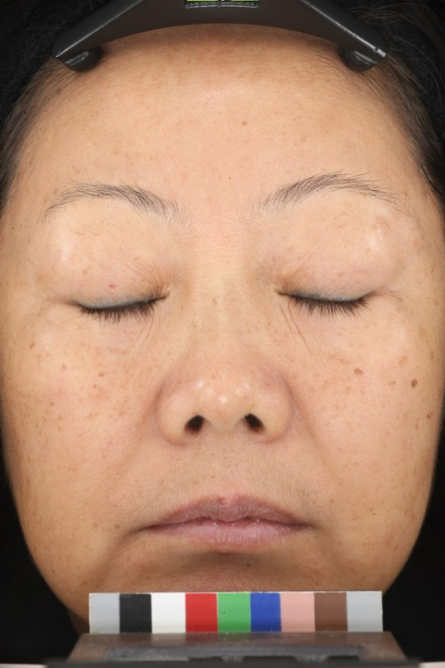

Clinical Results: Subject 2 after 12 weeks
Before
After
Visible improvements in eye wrinkles
Prepared for Nu Skin (2015). [12-Week Clinical Study to Evaluate Anti-aging Efficacy of ageLOC Me ™ Serums]. Unpublished raw data.
The pictures shown were taken at baseline and at the conclusion of a 12 Week clinical study Nu Skin contracted out to a 3rd party research organization in China. 60 participants were recruited and were split into two groups. Each participant was randomly assigned to one of two predominant ageLOC Me serum combination. Clinical grading, self-assessment, instrumentation and photos were completed at Baseline, Weeks 1, 2, 4, 8 and 12. October 2015.
Notes:
Prepared for Nu Skin (2015). [12-Week Clinical Study to Evaluate Anti-aging Efficacy of ageLOC Me Serums]. Unpublished raw data.
The pictures shown were taken at baseline and at the conclusion of a 12 Week clinical study Nu Skin contracted out to a 3rd party research organization in China. 60 participants were recruited and were split into two groups. Each participant was randomly assigned to one of two predominant ageLOC Me serum combination. Clinical grading, self-assessment, instrumentation and photos were completed at Baseline, Weeks 1, 2, 4, 8 and 12. October 2015.

Slide 32


Clinical Results: Subject 3 after 12 weeks
Before
After
Visible improvements in skin tone
Prepared for Nu Skin (2015). [12-Week Clinical Study to Evaluate Anti-aging Efficacy of ageLOC Me ™ Serums]. Unpublished raw data.
The pictures shown were taken at baseline and at the conclusion of a 12 Week clinical study Nu Skin contracted out to a 3rd party research organization in China. 60 participants were recruited and were split into two groups. Each participant was randomly assigned to one of two predominant ageLOC Me serum combination. Clinical grading, self-assessment, instrumentation and photos were completed at Baseline, Weeks 1, 2, 4, 8 and 12. October 2015.
Notes:
Prepared for Nu Skin (2015). [12-Week Clinical Study to Evaluate Anti-aging Efficacy of ageLOC Me Serums]. Unpublished raw data.
The pictures shown were taken at baseline and at the conclusion of a 12 Week clinical study Nu Skin contracted out to a 3rd party research organization in China. 60 participants were recruited and were split into two groups. Each participant was randomly assigned to one of two predominant ageLOC Me serum combination. Clinical grading, self-assessment, instrumentation and photos were completed at Baseline, Weeks 1, 2, 4, 8 and 12. October 2015.

Slide 33


Clinical Results: Subject A after 16 weeks
Before
After
Skin tone is more even
Forehead wrinkles appear smoother
Prepared for Nu Skin (2015). [16-Week Clinical Study to Evaluate Anti-aging Efficacy of ageLOC Me ™ Serums]. Unpublished raw data.
The pictures shown were taken at baseline and at the conclusion of a 16 Week clinical study Nu Skin contracted out to a 3rd party research organization in the United States. 60 participants were recruited and were split into two groups. Each participant was randomly assigned to one of two predominant ageLOC Me serum combination. Clinical grading, self-assessment, instrumentation and photos were completed at Baseline, Weeks 1, 4, 8, 12 and 16. March 2015.
Notes:
Prepared for Nu Skin (2015). [16-Week Clinical Study to Evaluate Anti-aging Efficacy of ageLOC Me Serums]. Unpublished raw data.
The pictures shown were taken at baseline and at the conclusion of a 16 Week clinical study Nu Skin contracted out to a 3rd party research organization in the United States. 60 participants were recruited and were split into two groups. Each participant was randomly assigned to one of two predominant ageLOC Me serum combination. Clinical grading, self-assessment, instrumentation and photos were completed at Baseline, Weeks 1, 4, 8,12 and 16. March 2015.

Slide 34


Clinical Results: Subject B after 16 weeks
Before
After
Reduced prominence of nasolabial fold
Prepared for Nu Skin (2015). [16-Week Clinical Study to Evaluate Anti-aging Efficacy of ageLOC ™ Serums]. Unpublished raw data.
The pictures shown were taken at baseline and at the conclusion of a 16 Week clinical study Nu Skin contracted out to a 3rd party research organization in the United States. 60 participants were recruited and were split into two groups. Each participant was randomly assigned to one of two predominant ageLOC Me serum combination. Clinical grading, self-assessment, instrumentation and photos were completed at Baseline, Weeks 1, 4, 8, 12 and 16. March 2015.
Notes:
Prepared for Nu Skin (2015). [16-Week Clinical Study to Evaluate Anti-aging Efficacy of ageLOC Me Serums]. Unpublished raw data.
The pictures shown were taken at baseline and at the conclusion of a 16 Week clinical study Nu Skin contracted out to a 3rd party research organization in the United States. 60 participants were recruited and were split into two groups. Each participant was randomly assigned to one of two predominant ageLOC Me serum combination. Clinical grading, self-assessment, instrumentation and photos were completed at Baseline, Weeks 1, 4, 8,12 and 16. March 2015.

Slide 35


Clinical Results: Subject C after 16 weeks
Reduced prominence of nasolabial fold
Softening of marionette line
Before
After
Prepared for Nu Skin (2015). [16-Week Clinical Study to Evaluate Anti-aging Efficacy of ageLOC Me ™ Serums]. Unpublished raw data.
The pictures shown were taken at baseline and at the conclusion of a 16 Week clinical study Nu Skin contracted out to a 3rd party research organization in the United States. 60 participants were recruited and were split into two groups. Each participant was randomly assigned to one of two predominant ageLOC Me serum combination. Clinical grading, self-assessment, instrumentation and photos were completed at Baseline, Weeks 1, 4, 8, 12 and 16. March 2015.
Notes:
Prepared for Nu Skin (2015). [16-Week Clinical Study to Evaluate Anti-aging Efficacy of ageLOC Me Serums]. Unpublished raw data.
The pictures shown were taken at baseline and at the conclusion of a 16 Week clinical study Nu Skin contracted out to a 3rd party research organization in the United States. 60 participants were recruited and were split into two groups. Each participant was randomly assigned to one of two predominant ageLOC Me serum combination. Clinical grading, self-assessment, instrumentation and photos were completed at Baseline, Weeks 1, 4, 8,12 and 16. March 2015.

Slide 36




ageLOC ME LAUNCH Plan - 2016
MAY
JUNE
JULY
AUG
SEPT
OCT
NOV
DEC
JAN
SPOKANE
PANAMA SUCCESS TRIP QUALIFICATION
SUCCESS TRIP
QUALIFICATION
LEADER PREVIEW
Stars (Orlando Qualifiers) 2 Units or 4 Units
PRE-LAUNCH EVENT (Nov 15 – Dec 15)
CONVENTION PREVIEW
1 Unit Per Attendee
LAUNCH
January 10
NEW EXEC + UPLINE EXEC 1 Unit each (Codes Awarded on July 15, August 17, Sept 14, Oct 12, Nov 16)

Slide 37


The Future Is Here…Are You Ready?

