Slide 1
PRODUCT SHARING GUIDE

Slide 2

PRODUCT SHARING GUIDE STEPS
EXPERIENCE
YOUR AGELOC ME SYSTEM.
REVIEW
THE APPROVED MESSAGING FOR AGELOC ME, THE INSPIRATION BEHIND THE PRODUCT, AND LEARN HOW AGELOC ME FITS INTO NU SKIN’S PORTFOLIO.
DEVELOP
YOUR PERSONAL STORY AND TESTIMONIAL.
SHARE
AGELOC ME WITH OTHERS.

Slide 3

EXPERIENCE

Slide 4

REDEFINING THE SKIN CARE EXPERIENCE
Nu Skin has redefined skin care with ageLOC Me, an entirely new approach to anti-aging. Featuring five powerful, cutting-edge products and one smart delivery device, ageLOC Me is anti-aging skin care like you’ve never seen, felt, or imagined.
Every day is a confident, beautiful skin day.

Slide 5
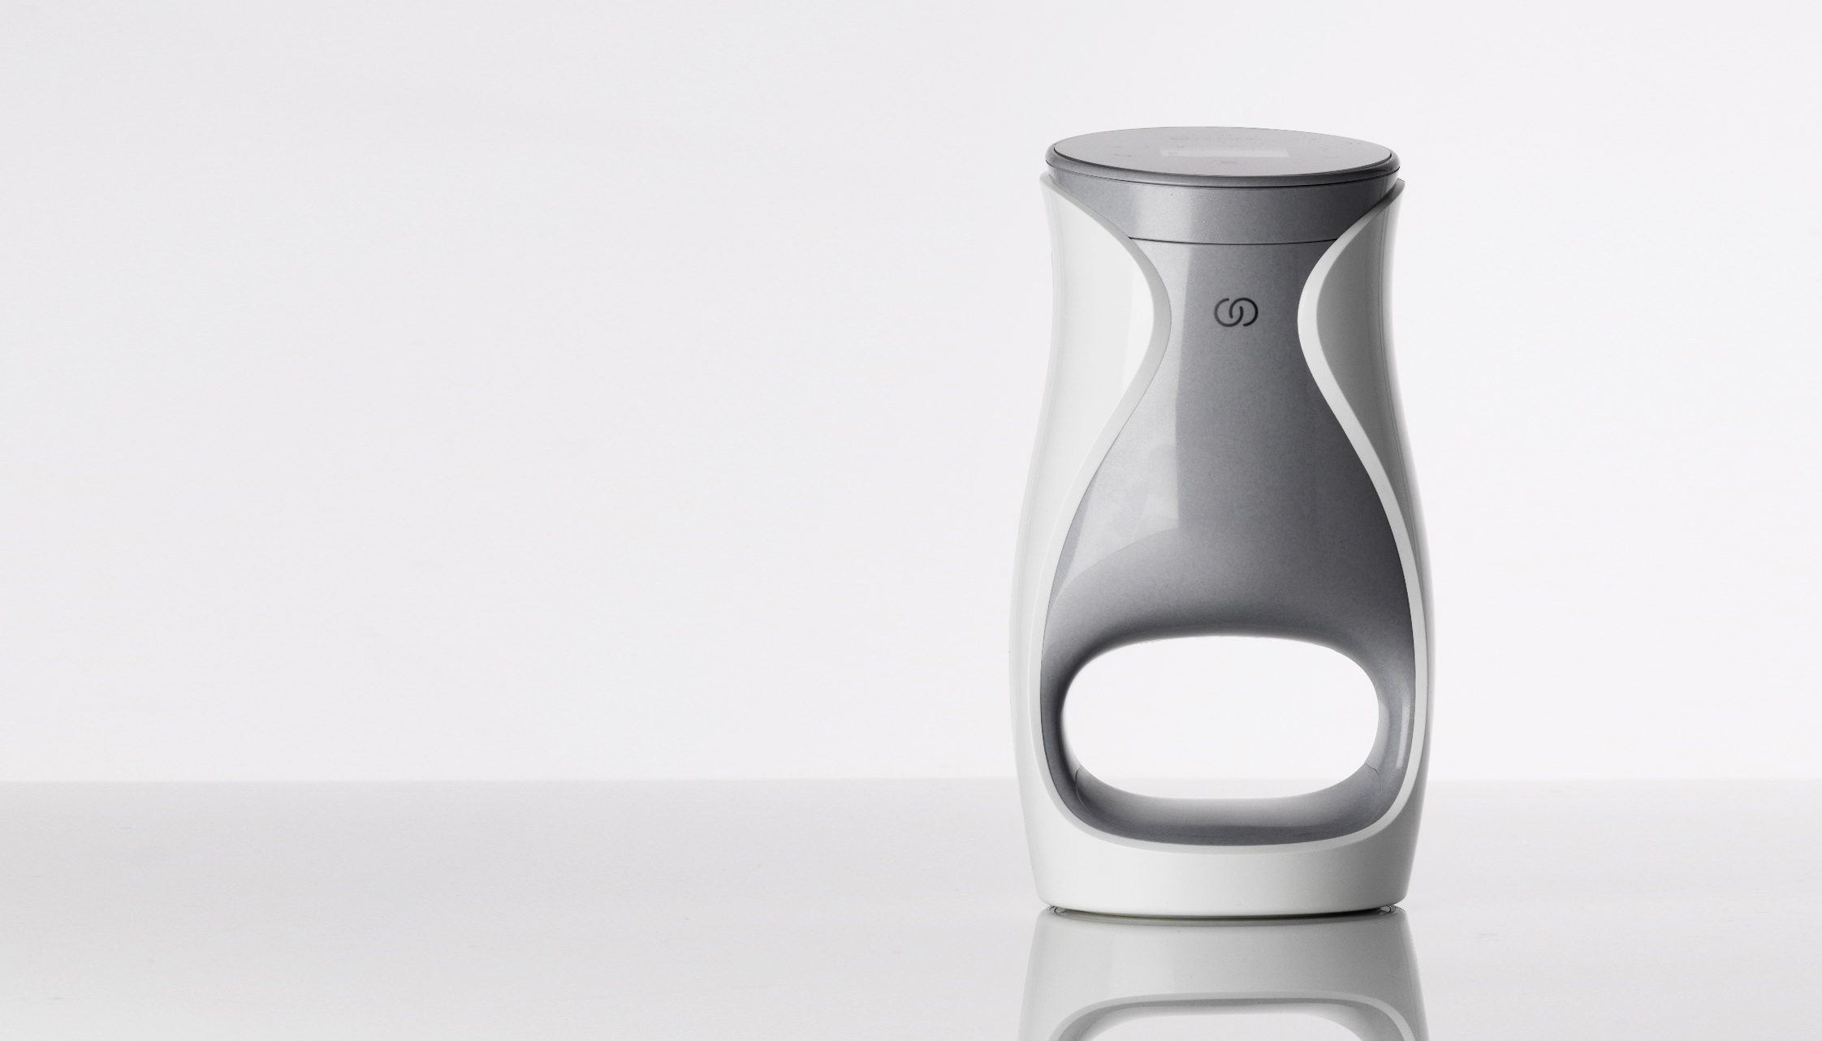
INTRODUCING AGELOC ME™
AGELOC ME CAPITALIZES ON THE HOTTEST
PRODUCT TRENDS AND IS PART OF MULTIPLE CATEGORIES EXPERIENCING SUBSTANTIAL GROWTH.
ageLOC Me is inspired by more than 30 years of anti-aging science and provides a unique and customized skin care experience that is exclusive and smart, and makes your anti-aging routine simple and convenient.

Slide 6

REVIEW: TRENDS
WHY AGELOC ME?

Slide 7

The anti-aging industry is growing.
The aging population is increasing and younger people want to avoid early signs of aging.
REVIEW: TRENDS
THE GLOBAL MARKET
FOR ANTI-AGING PRODUCTS
IS SET TO REACH $346 BILLION BY 2018.
“ANTI-AGING PRODUCT AND SERVICES: THE GLOBAL MARKET,” BCC RESEARCH, AUGUST 2013

Slide 8

Skin care is a rapidly growing category.
REVIEW: TRENDS
Skin care is set to reach $405 billion by 2017, growing by more than $55 billion in 5 years.
EUROMONITOR INTERNATIONAL, JULY 2014

Slide 9
Product customization is becoming increasingly popular.
REVIEW: TRENDS
Consumers are moving away from traditional, mass-produced products. They are increasingly looking for solutions that fit their specific needs and engaging in product creation.
“FIVE GAME-CHANGING CONSUMER TRENDS,” BUSINESS DEVELOPMENT BANK OF CANADA, 2013

Slide 10
Consumers seek expertise and simplicity.
REVIEW: TRENDS
Consumers often seek guidance from experts on which beauty items to buy.
But once they know their regimen, they look for ways to simplify the buying process.
“SHOPPING FOR BEAUTY PRODUCTS,” MINTEL, US, DECEMBER 2013

Slide 11
Our busy lifestyles require products that are convenient.
REVIEW: TRENDS
SAVVY SPENDERS ARE ATTRACTED TO BRANDS THAT PROVIDE PRODUCTS AND SERVICES WITH BUILT-IN CONVENIENCES.
“FACEWASH AND GO,” MINTEL, JANUARY 2013

Slide 12
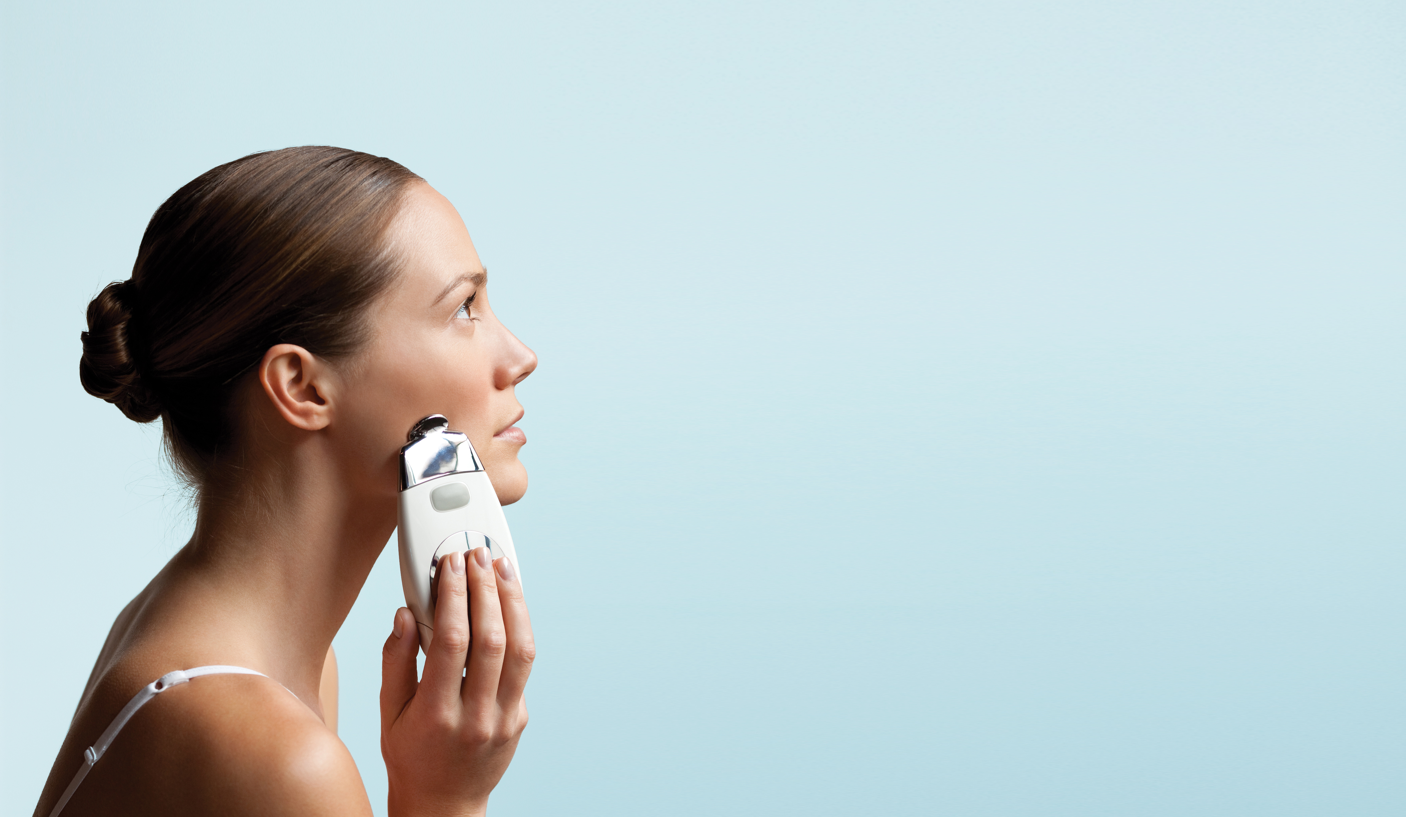
High-tech beauty gadgets are in high demand.
REVIEW: TRENDS
70%
OF WOMEN WOULD LIKE TO OWN A NEW BEAUTY DEVICE.
“BEAUTY DEVICES ARE ‘CREATING A NEW BENCHMARK IN FACIAL SKINCARE,’” COSMETICS DESIGN, 2013

Slide 13
REVIEW: MESSAGING
APPROVED KEY POINTS

Slide 14

1
ADVANCED ANTI-AGING SCIENCE
ageLOC Me delivers Nu Skin’s most advanced anti-aging science in a unique and impressive system for a completely new skin care experience. ageLOC products target the sources of aging to help you look and feel younger.
REVIEW: MESSAGING
KEY POINTS
Nu Skin’s most advanced ageLOC formulations inspired by more than 30 years of anti-aging science
Science that targets aging at its source
Cutting-edge, breakthrough products developed by anti-aging experts

Slide 15

2
CUSTOMIZED
CUSTOMIZATION IS WHAT DRAWS A CUSTOMER TO A BRAND.
ageLOC Me helps people find the right solution for their individual skin care needs.
REVIEW: MESSAGING
PREDICTING MARKET SUCCESS: NEW WAYS TO MEASURE CUSTOMER LOYALTY, ROBERT PASSIKOFF, 2006
Customization increases brand loyalty and engagement and increases the likelihood that a customer will share their experience with others and be more satisfied with the product result.
“MAKING IT PERSONAL: RULES FOR SUCCESS IN PRODUCT CUSTOMIZATION,” BAIN & COMPANY, 2013

Slide 16

3
EXCLUSIVE AND SMART
There is nothing like ageLOC Me anywhere else. It is an entirely new smart skin care experience available exclusively from Nu Skin distributors.
REVIEW: MESSAGING
KEY POINTS
Smart delivery device
One of a kind—offered only by Nu Skin
Patents pending for function and design
First-of-its-kind technology
World-class design
BEAUTY DEVICES ARE TRANSFORMING THE SKIN CARE MARKET, ESPECIALLY IN THE UNITED STATES, CHINA, AND EUROPE.
“BEAUTY DEVICES ARE ‘CREATING A NEW BENCHMARK IN FACIAL SKINCARE,’” COSMETICS DESIGN, 2013

Slide 17
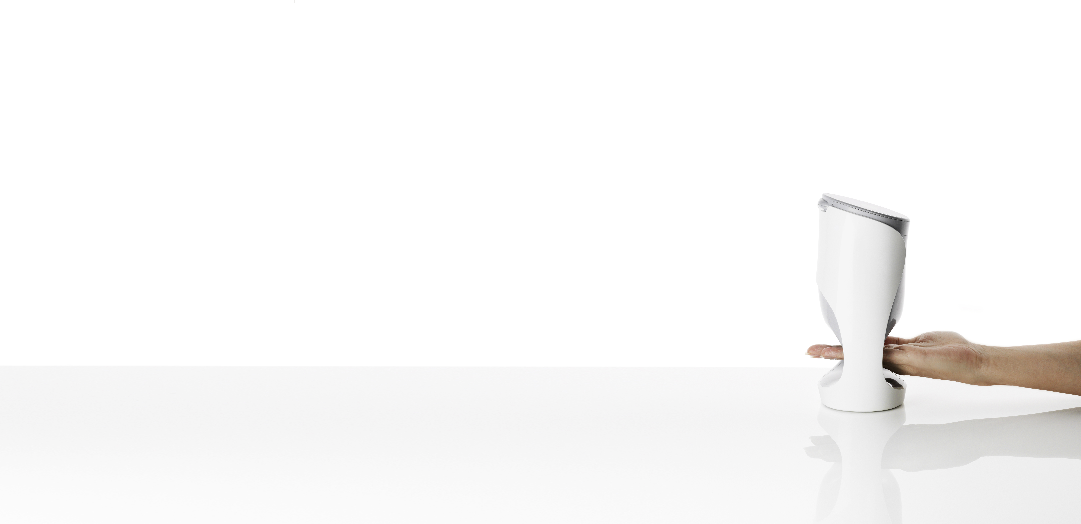
4
SIMPLE AND CONVENIENT
People are interested in anti-aging skin care and want to take care of their skin, but they may have questions and need guidance. They are looking for ways to save time and simplify their lives. ageLOC Me makes it easier and more convenient to adopt and stick to a skin care routine.
REVIEW: MESSAGING
CONSUMERS TODAY PREFER SIMPLICITY, MORE CONVENIENCE, AND GREATER EASE OF USE IN THE PRODUCTS THEY BUY.
27% of people shopping for anti-aging skin care products are confused by all the products available.
“SIMPLIFICATION: OPPORTUNITY FOR BRANDS,” BRAND STRATEGY INSIDER, JULY 2013
“ANTI-AGING SKINCARE—US IN EXPERIENCE IS ALL,” MINTEL, FEBRUARY 2014

Slide 18
REVIEW: USAGE AND FIT
QUESTIONS ABOUT AGELOC ME

Slide 19

USING AGELOC ME
We encourage you to experience all of the features of your ageLOC Me Starter Kit.
YOUR AGELOC ME STARTER KIT INCLUDES
ageLOC Me smart delivery device
Reference Set of five product cartridges including Day Moisturizer, Night Moisturizer, and three Serums
Access to comprehensive ageLOC Me skin assessment via app or website
Travel container
REVIEW: USAGE AND FIT

Slide 20
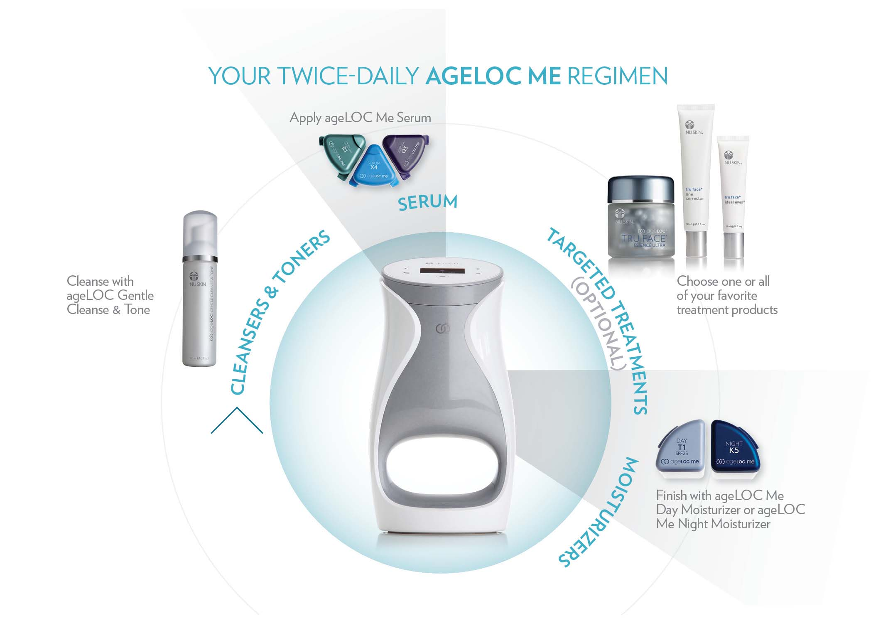
Products Compatible with ageLOC Me and Suggested Uses
REVIEW: USAGE AND FIT

Slide 21
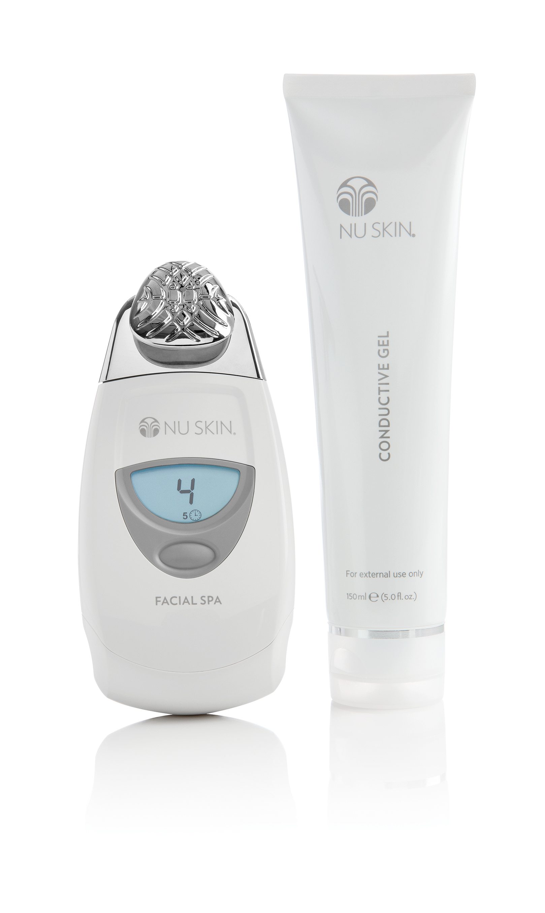
ageLOC Me and Nu Skin Facial Spa
ageLOC Me is a comprehensive, daily use system that complements your Spa routine. Both products are based on cutting edge science and, when used together, provide powerful results for your skin and your Nu Skin business.
REVIEW: USAGE AND FIT
Use Nu Skin Facial Spa 2-3 times weekly after cleansing and toning, right before applying your ageLOC Me Serum

Slide 22

DEVELOP YOUR STORY

Slide 23

Your Story
Great stories share a formula. For a product story that makes an impact, you need both of these critical components.
PERSONAL MOMENT
A personal moment helps you connect and relate with others in a natural way. It helps you define a concern or issue the product or company helps to solve. This is a lead-in to your testimonial.
TESTIMONIAL A statement about the results and benefits you experience using the product or from your involvement with Nu Skin.
DEVELOP YOUR STORY

Slide 24
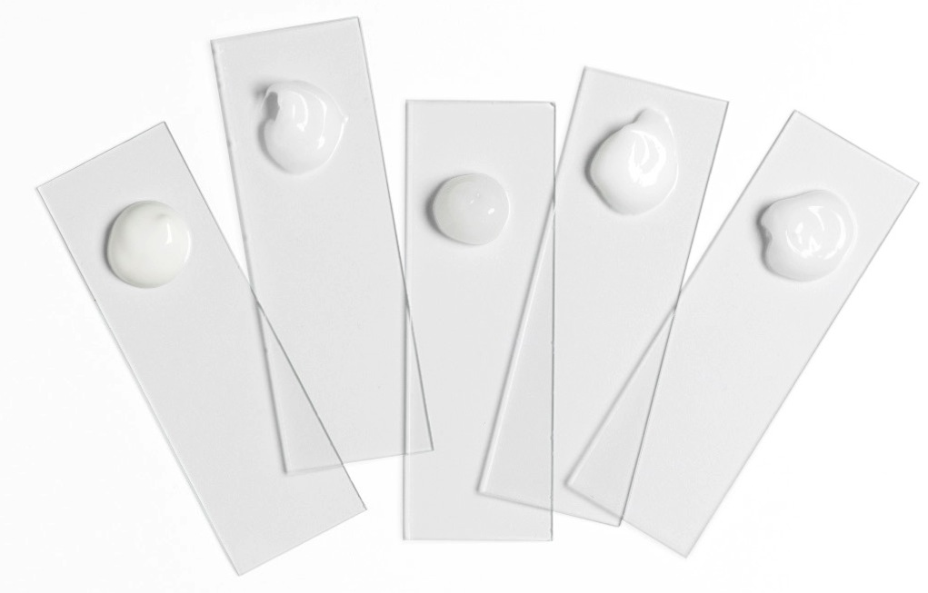
Your story about
ADVANCED ANTI-AGING SCIENCE
PERSONAL MOMENT EXAMPLE
“I’ve bought a lot of products elsewhere that make grandiose claims. I haven’t always been happy with the results. How do I know I can trust that a product will do what it says it will?”
Develop Your Own Personal Moment
TESTIMONIAL EXAMPLE
“Since I started using ageLOC Me, I feel more confident in my skin because I can see results. My skin looks younger and the lines and wrinkles in my face are less visible. This, to me, reaffirms that Nu Skin science works. It has made me a believer.”
Develop Your Own Testimonial
DEVELOP YOUR STORY
All marketing materials (product claims, testimonials, social media posts, etc.) must comply with Nu Skin’s Policies and Procedures— please see the Nu Skin Product Sharing Guidelines at https://www.nuskin.com/content/nuskin/en_US/corporate/regulatory_corner.html for more information about how to properly create your personal story.

Slide 25

TESTIMONIAL EXAMPLE
“With the assessment questionnaire, I chose my skin care preferences based on my skin
type and environment. Afterward, I received my personal skin care code for my customized
products—products that address my personal skin care needs. Because the products
are customized, I feel like I’m getting more of the results I want.”
Develop Your Own Testimonial
Your story about
CUSTOMIZATION
PERSONAL MOMENT EXAMPLE
“Everyone’s skin is different, so how do I know which products are best for my skin? I’m looking for products that can meet my distinct skin care needs and concerns.”
Develop Your Own Personal Moment
DEVELOP YOUR STORY
All marketing materials (product claims, testimonials, social media posts, etc.) must comply with Nu Skin’s Policies and Procedures— please see the Nu Skin Product Sharing Guidelines at https://www.nuskin.com/content/nuskin/en_US/corporate/regulatory_corner.html for more information about how to properly create your personal story.

Slide 26
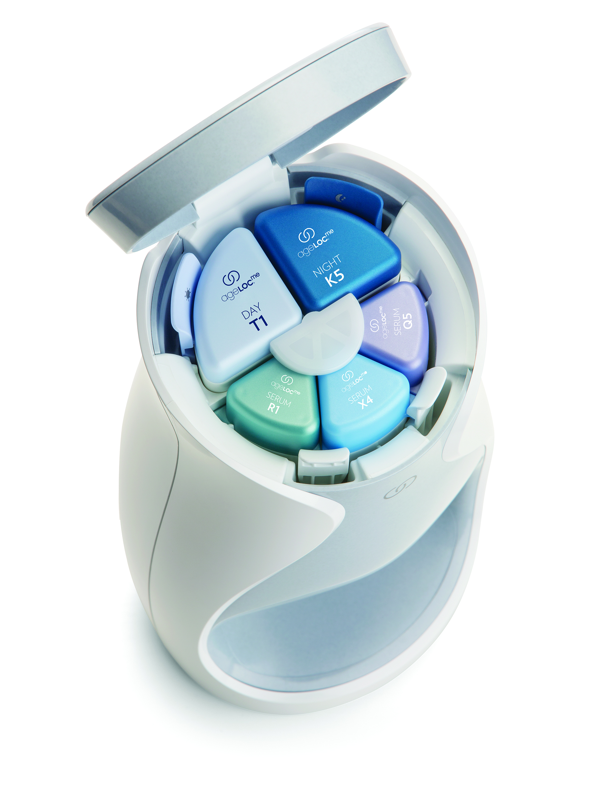
Your story about
EXCLUSIVITY AND SMART TECHNOLOGY
PERSONAL MOMENT EXAMPLE
“I love technology and am always one of the first to buy the latest smartphone or gadget. I’m always on the lookout for what’s hip and am excited to get my hands on the newest must-have gadgets.”
Develop Your Own Personal Moment
TESTIMONIAL EXAMPLE
“ageLOC Me is amazing and so high-tech. It’s the perfect solution for someone like me. I also love that the system ‘learns’ my routine and has a variety of modes I can choose from based on my preferences.”
Develop Your Own Testimonial
DEVELOP YOUR STORY
All marketing materials (product claims, testimonials, social media posts, etc.) must comply with Nu Skin’s Policies and Procedures— please see the Nu Skin Product Sharing Guidelines at https://www.nuskin.com/content/nuskin/en_US/corporate/regulatory_corner.html for more information about how to properly create your personal story.

Slide 27
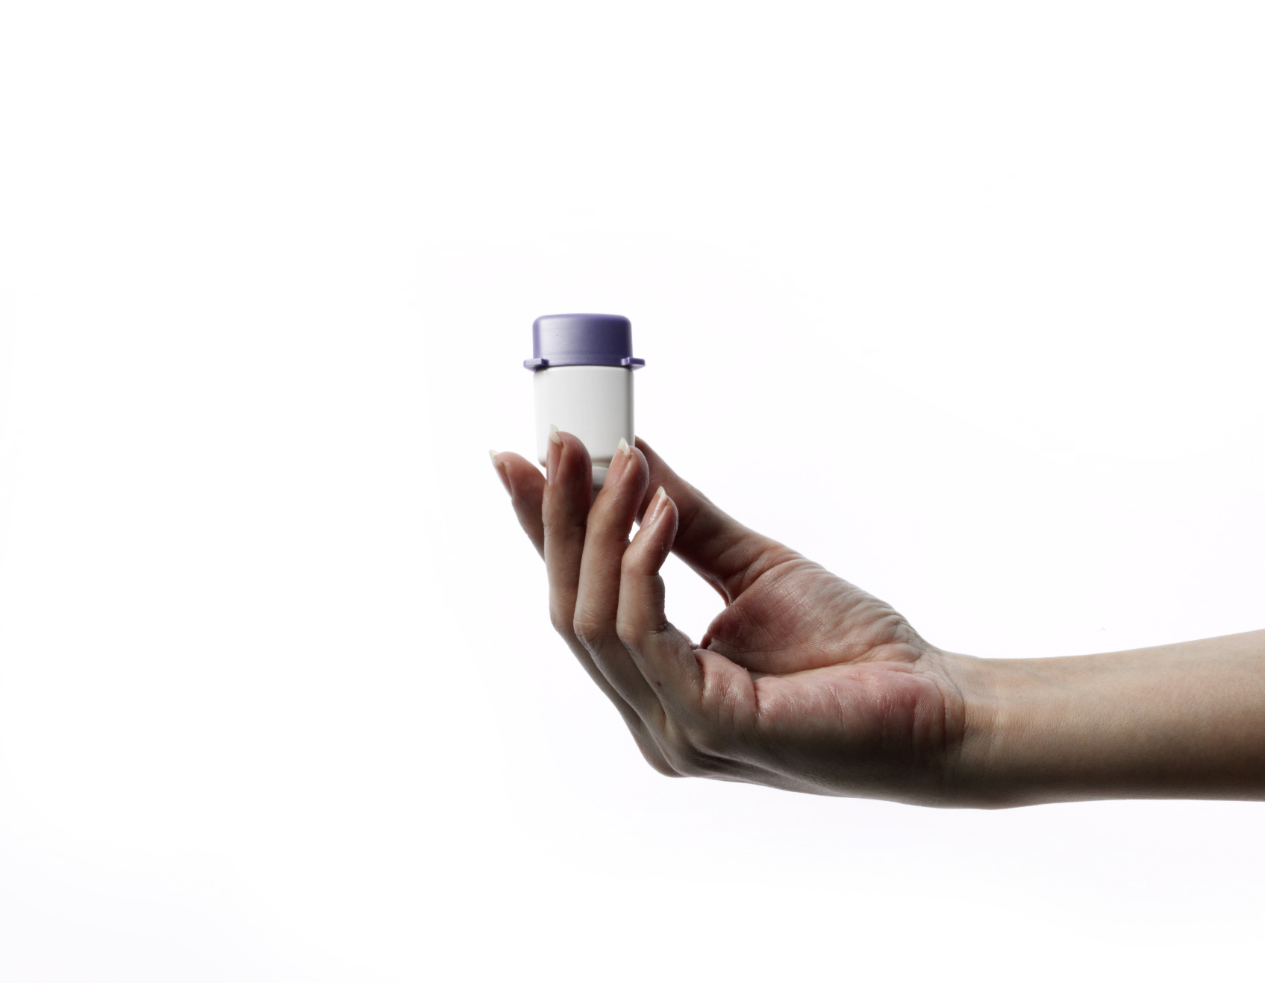
Your story about
SIMPLICITY AND CONVENIENCE
PERSONAL MOMENT EXAMPLE
“I often don’t realize my skin care products are almost out until I squeeze the tubes and nothing comes out. It can be such an inconvenience to suddenly have to run out the next day to get more product.”
Develop Your Own Personal Moment
TESTIMONIAL EXAMPLE
“With ageLOC Me, I get an automatic refill delivery every month, and the system keeps track of my doses. So I never have to worry that I’m going to run out of product. ageLOC Me gives me the perfect dose every time and is so simple to use.”
Develop Your Own Testimonial
DEVELOP YOUR STORY
All marketing materials (product claims, testimonials, social media posts, etc.) must comply with Nu Skin’s Policies and Procedures— please see the Nu Skin Product Sharing Guidelines at https://www.nuskin.com/content/nuskin/en_US/corporate/regulatory_corner.html for more information about how to properly create your personal story.

Slide 28

SHARE: TIPS AND IDEAS

Slide 29
Conversation Starters
Now that you’ve developed a personal story and testimonial, you can more easily talk about your experience in a natural way with others.
SOME OPPORTUNITIES FOR CONVERSATION:
Response to a compliment or inquiry
You look great. Are you doing something different?
Yes, actually. I was having a hard time sticking with a skin care routine because I’m so busy until I found…..
I noticed an interesting addition to your vanity. What is that?
I know that, like me, you love the latest technology. This is exclusive, high tech, anti-aging skin care. I have to show this to you.
Ask a question
Do you notice anything different about me?
I’ve been excited to talk to you about the results of my new customized skin care routine.
SHARE TIPS AND IDEAS

Slide 30
Share Via Social Network
Post a picture of your ageLOC Me products on Facebook or Instagram with one of the following options
Share your personal moment and testimonial for one of the product messaging points.
I can’t get over how great my skin looks since I started using products customized for me. It’s made me a believer! Ask me how you can get customized skin care today.
Finally, I have a skin care regimen that addresses my particular needs. Comment if you’re interested in learning more.
ageLOC Me is my new favorite beauty gadget. It’s a completely new and unique skin care experience. I’d love to conduct a demonstration for you!
My ageLOC Me skin care system is amazing. It learns my skin care routine, keeps track of remaining doses, and comes with a handy travel container so I never have to go a day without. Message me if you’d like to learn more.
SHARE TIPS AND IDEAS
OR use these ideas to create your own posts
All marketing materials (product claims, testimonials, social media posts, etc.) must comply with Nu Skin’s Policies and Procedures— please see the Nu Skin Product Sharing Guidelines at https://www.nuskin.com/content/nuskin/en_US/corporate/regulatory_corner.html for more information about how to properly create your personal story.

Slide 31
PRODUCT SHARING GUIDE

